Slide 1

A MASTER PLAN for DERRY
Public Forum #3:
Presenting the Plan
Wednesday, Oct. 30, 2019
Municipal Complex
3rd Floor Meeting Room

Slide 2




Master Plan Update Team
  Derry Planning Department
George Sioras
Planning Director
Elizabeth Robidoux
Planning Assistant
Community Circle
Consultant Team
Daphne Politis,
Community Circle
Martha Lyon,
Martha Lyon Landscape Architecture, LLC
Judi Barrett,
Barrett Planning Group, LLC
Fiona Coughlan,
Barrett Planning Group, LLC
Jeff Maxtutis,
BETA Group Inc.

Slide 3
WHAT IS A MASTER PLAN ?
A basis for decision-making for future development
A process leading to a plan of action based on a town’s shared values and goals
A set of priorities for addressing the full range of issues facing a town
What to preserve?
What to change?
Concerns?
Improvements?
Ensure that Derry’s desirable features are preserved and challenges are addressed.

Slide 4
WHY PLAN ?
Take stock, review objectives, direction and priorities
Examine resource allocation: existing and optimal
Last complete plan - 2010
Be proactive and affect future decision making
Support eligibility for grant programs and public funds
A Master Plan is an important opportunity to think about:
How can we make Derry an even better place to live, work and play?
Approximately 90% of action items have been accomplished from the 2010 Plan

Slide 5
THE PROCESS
Community Conversation
(input from residents, business leaders, & Town officials)
What do we have?
What do we want?
What is most important?
How do we get there?
Inventory of Existing Resources
(what do we have?)
Vision & Goals
(what do we want?)
Opportunities Challenges
Priorities
(what is most
important)
Implementation Plan
(how do we get there?)

Slide 6
VISION AND GOALS:
Developed with input from various forums
WHAT DERRY“WANTS”
Over (20) Leadership Interviews
Public Forum: Nov. 28, 2018 (approx. 70 people)
Public Forum: April 6, 2019
(approx. 60 people)
Comment Boards
  Town Hall
  Veteran’s Memorial Hall
Visioning with high school students @ Pinkerton Academy (approx. 30)
  Downtown Visioning Public Forum: Jan. 29, 2019 (60 participants)
LAND USE DISTRICTS AND STANDARDS
FOR AREAS WITHIN THE JURISDICTION OF THE MAINE LAND USE PLANNING COMMISSION
Review of relevant
SURVEY RESPONSES:
    SNHPC Age-friendly survey conducted (405 respondents)
    Survey regarding downtown improvements (252 respondents)
    Survey of young adults (136 respondents)
Multiple conversations with Derry Planning Staff; input from the Planning Board
Notes:
Downtown Vitality:
Housing affordable to middle class and artists
Parking
Preservation of scale and historic features in development and redevelopment – need tools
Corridor areas -- Preserve Portsmouth’s character while guiding desirable change
Create a vision for each corridor being mindful of the distinct character of each
EXAMPLES
Supporting a diverse community is primarily about providing affordable housing
Resource protection and sustainability with regard to historic resources, natural resources and climate change

Slide 7
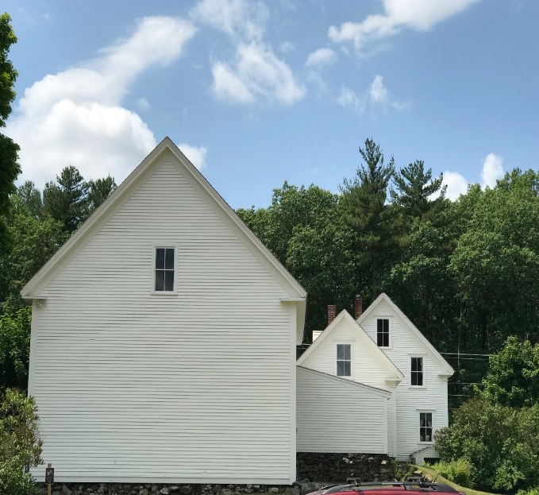
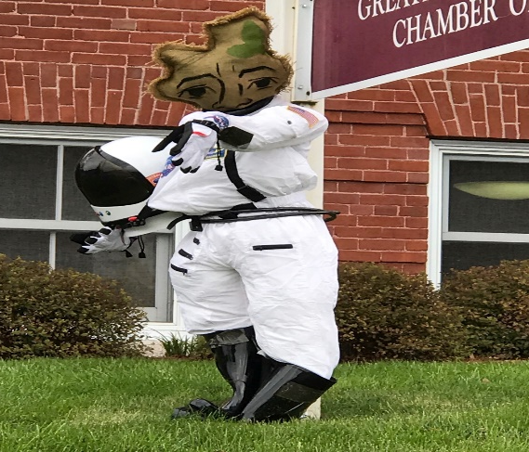
APPROACH
Identify & define what makes Derry unique
“Derry is located within one hour of cultural activities, the beach, skiing, major metropolitan areas and opportunities to engage in a variety of sports.”
Small town feel wonderful people close- knit community community spirit
Marion Gerrish Community Center vibrant walkable downtown
great location easy access to mountains, beaches, cities
Conservation lands Rail Trail Beaver Lake Community garden
Potatoes: “First in the Nation” Annual Trick or Treat Holiday parades
Great Schools Pinkerton Academy school programs & opportunities
Golf course Boys and Girls Club spud crows
Vibrant arts community Tupelo Music Hall Stockbridge Theater Opera House
Farmer’s Market Derry After Dark Derryfest
History Alan Shepherd, Robert Frost, potatoes Heritage Trail Hood Park
Resilience, renewable energy, net zero goals various housing options affordability
Local restaurants craft breweries and distilleries coffee shops Hospital

Slide 8
PRELIMINARY VISION
Developed with input from various forums
WHAT DERRY “WANTS”
Imagine a Derry… that retains its small-town feeling, even enhances the community’s feeling of being close knit, by welcoming newcomers and increasing communication between the Town and its residents, holding more festivals and events.
Imagine a Derry… that has become a destination with much to do and see both for residents and visitors alike. The downtown is welcoming and walkable with plenty of parking to support the mix of uses including offices, housing, retail and restaurants. Promoting the growing arts community and cultural opportunities adds to the vitality and attracts new residents and visitors.
Imagine a Derry… that has expanded its economic base and created new opportunities for employment by becoming more business-friendly, investing in infrastructure that supports business growth, creating new commercial and industrial zones, reimagining the Downtown and Route 28,.
Imagine a Derry… that provides a wide range of housing for people in different stages of the lifecycle, income levels, and special needs.
Imagine a Derry… that provides recreational opportunities for all ages, including both indoor and outdoor facilities and programs. This includes a system of connected open spaces and lakes linked by trails and made more accessible by adding more parking, signage, and information regarding these.
Imagine a Derry… that protects and promotes its history and historic structures by enacting policies that ensure buildings.
Imagine a Derry… that retains its excellence in education and promotes this as a feature of living in Derry, attracting new families to live in Town.
Imagine a Derry… that provides a range of options for getting around town, including safe walking and biking and expansion of the existing public transit service, discouraging auto-dependency.
Imagine a Derry… that promotes the health and wellness of all its residents by encouraging physical activity.
Imagine a Derry… that is resilient and sustainable and uses renewable energy sources. It takes care of its elderly and attracts young people to relocate here so that the next generation can take over the stewardship of the Town’s assets and resources. Also, government is transparent and efficient.
LAND USE DISTRICTS AND STANDARDS
FOR AREAS WITHIN THE JURISDICTION OF THE MAINE LAND USE PLANNING COMMISSION
Notes:
Downtown Vitality:
Housing affordable to middle class and artists
Parking
Preservation of scale and historic features in development and redevelopment – need tools
Corridor areas -- Preserve Portsmouth’s character while guiding desirable change
Create a vision for each corridor being mindful of the distinct character of each
EXAMPLES
Supporting a diverse community is primarily about providing affordable housing
Resource protection and sustainability with regard to historic resources, natural resources and climate change

Slide 9
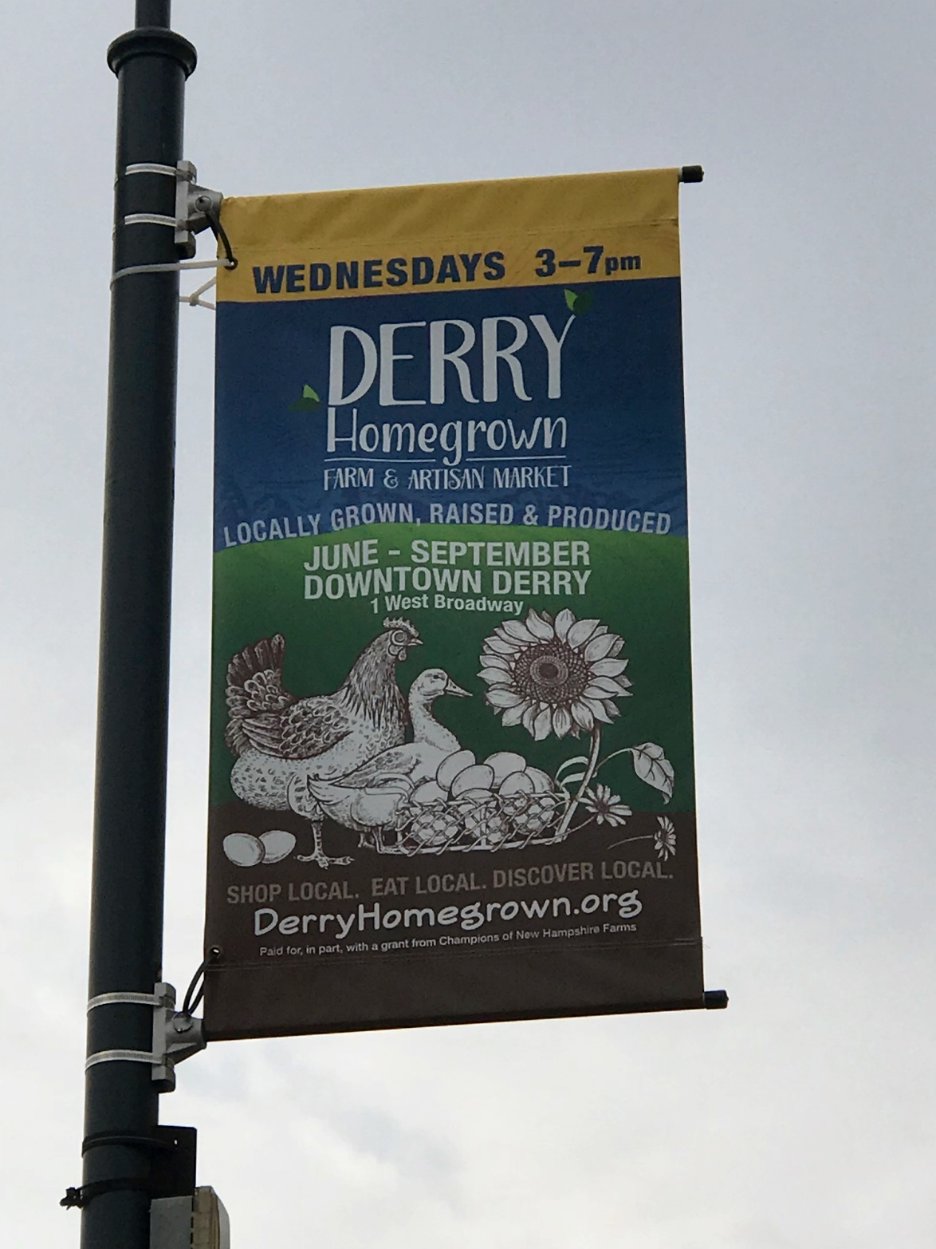
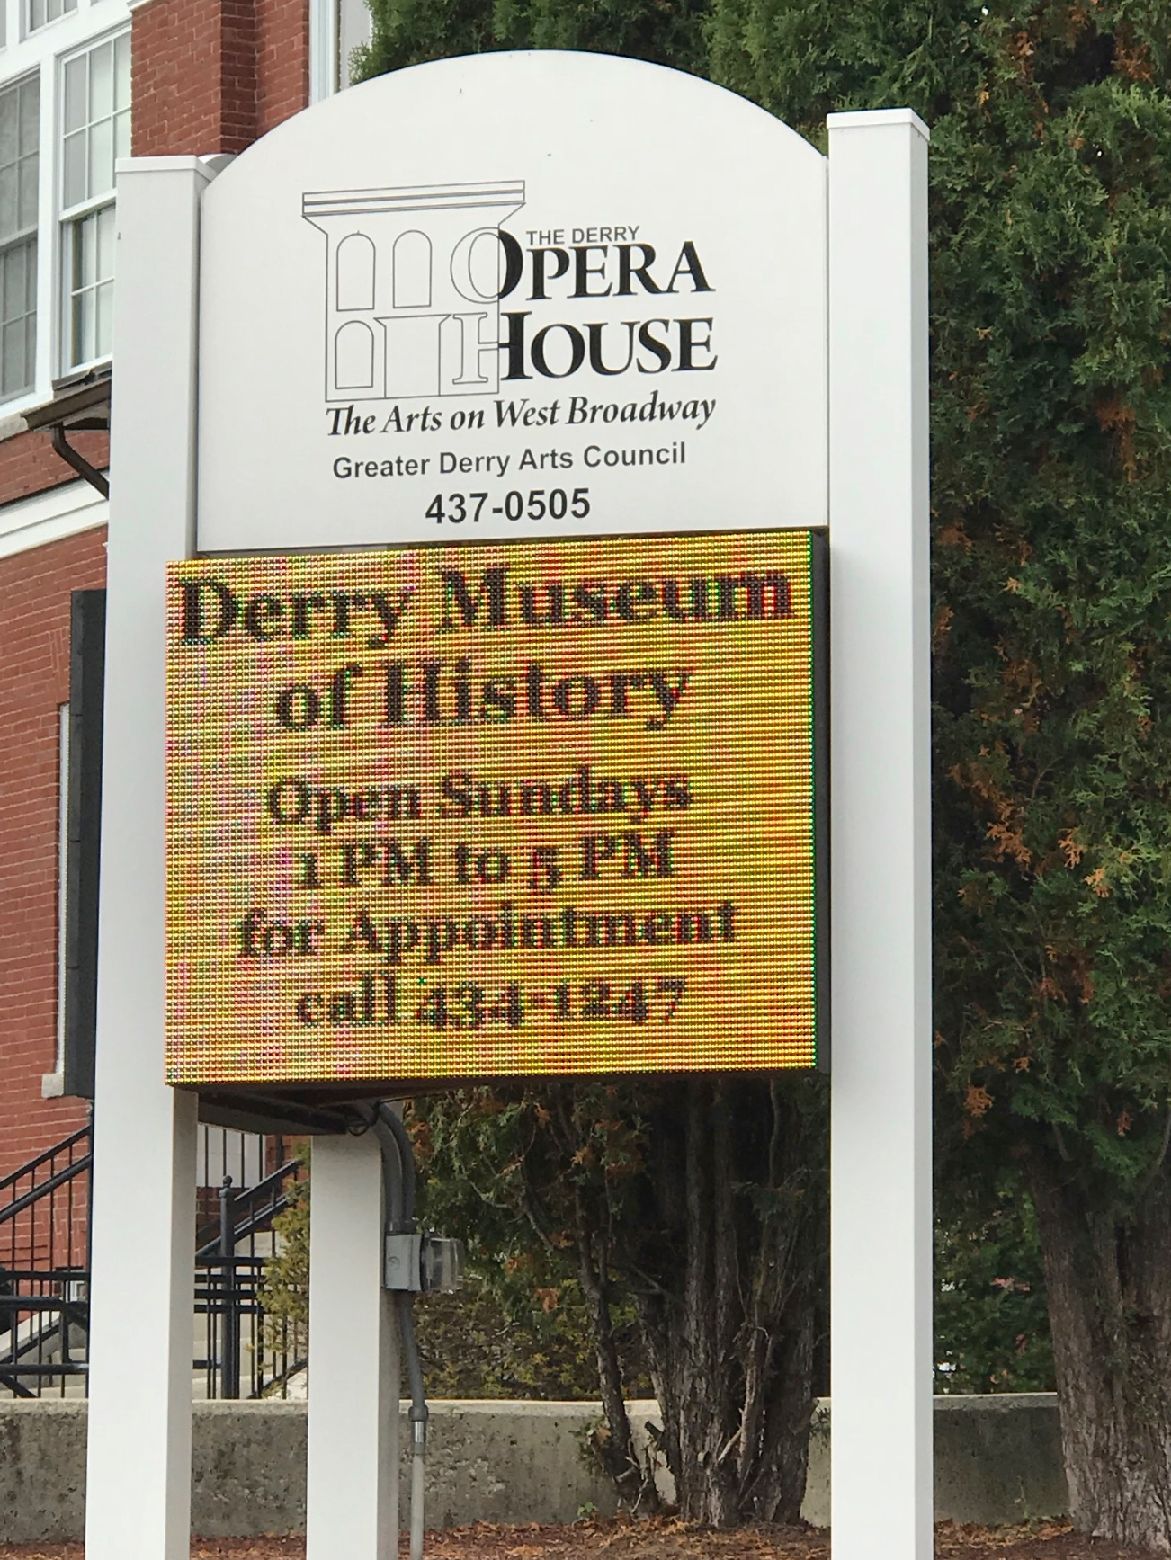
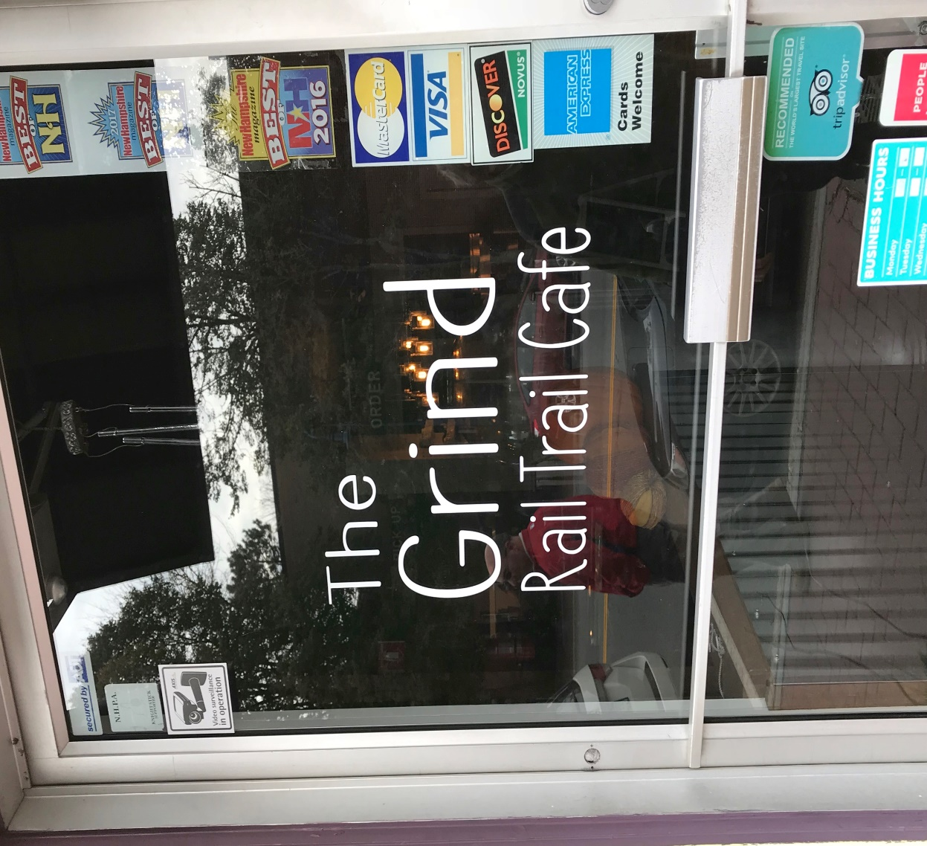
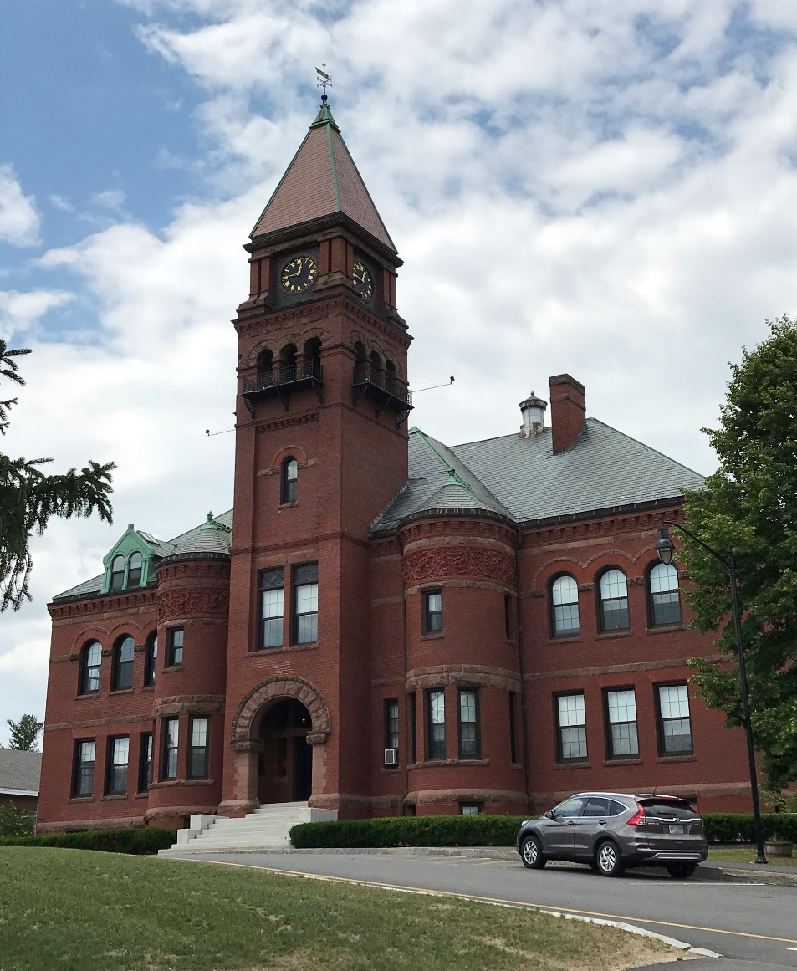
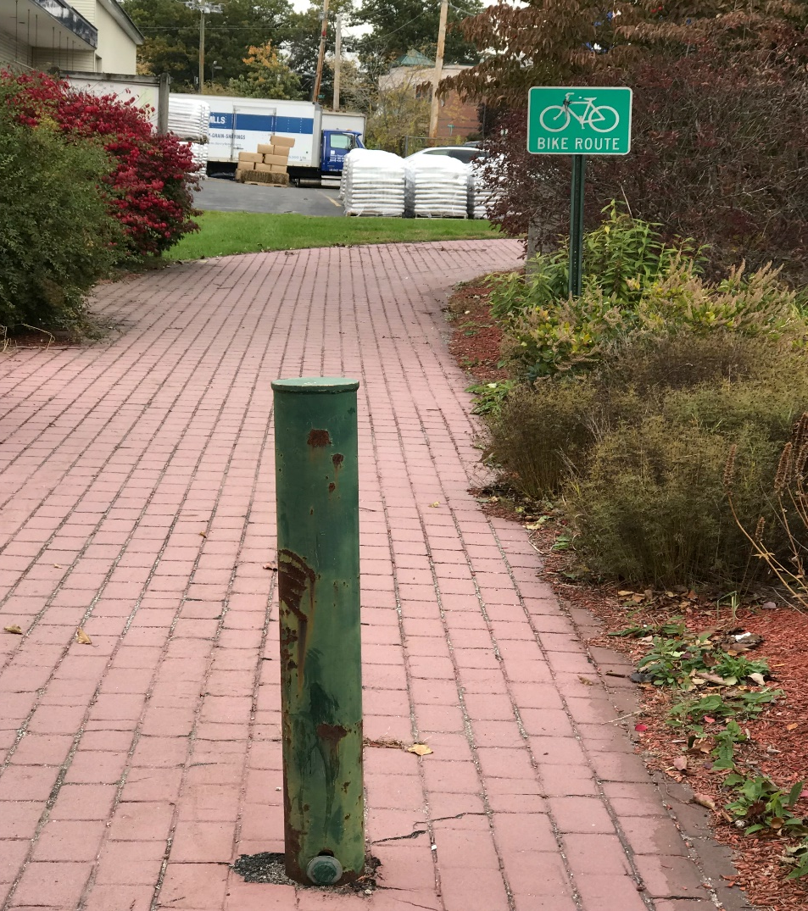
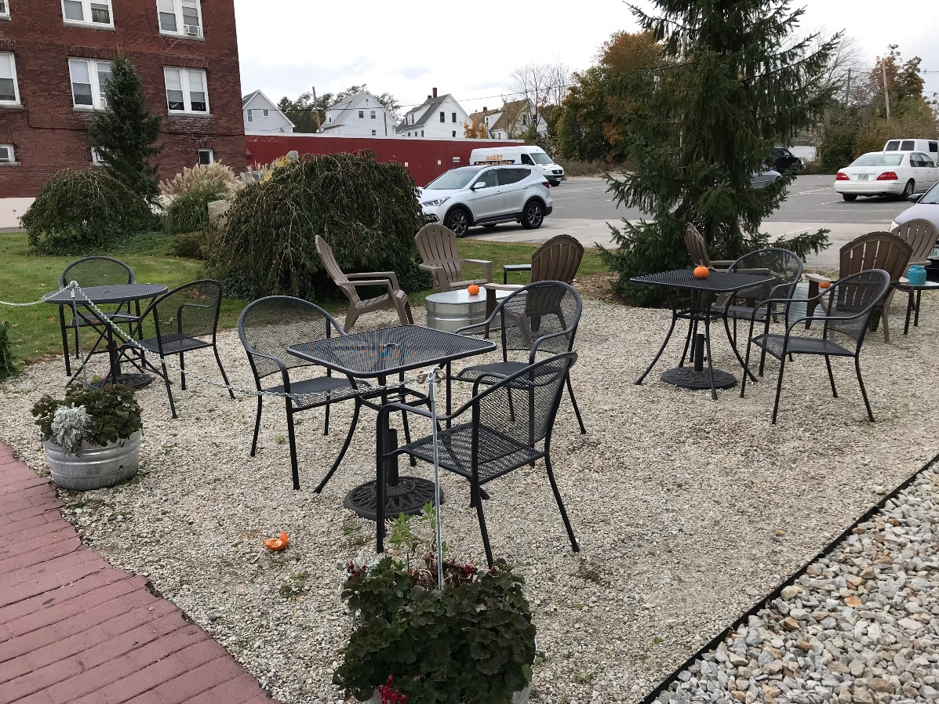
HIGHLIGHTS OF INVENTORY OF EXISTING RESOURCES:
WHAT DERRY “HAS”
LAND USE DISTRICTS AND STANDARDS
FOR AREAS WITHIN THE JURISDICTION OF THE MAINE LAND USE PLANNING COMMISSION
Notes:
Downtown Vitality:
Housing affordable to middle class and artists
Parking
Preservation of scale and historic features in development and redevelopment – need tools
Corridor areas -- Preserve Portsmouth’s character while guiding desirable change
Create a vision for each corridor being mindful of the distinct character of each
EXAMPLES
Supporting a diverse community is primarily about providing affordable housing
Resource protection and sustainability with regard to historic resources, natural resources and climate change

Slide 10
HIGHLIGHTS OF INVENTORY OF EXISTING RESOURCES:
Population & Demographics
Derry’s population is expected to continue to grow at very slow pace
Derry’s elder population is projected to increase
Derry has a broad mix of housing, much of it relatively affordable compared to other nearby towns
Half of all housing units are detached single-family homes
Renters comprise almost 40% of all households
The Town’s aging population will need housing and other services
The Town should consider ways to attract and retain a younger population to help fill jobs, support local businesses, and support the Town’s tax base.
LAND USE DISTRICTS AND STANDARDS
FOR AREAS WITHIN THE JURISDICTION OF THE MAINE LAND USE PLANNING COMMISSION
Notes:
Downtown Vitality:
Housing affordable to middle class and artists
Parking
Preservation of scale and historic features in development and redevelopment – need tools
Corridor areas -- Preserve Portsmouth’s character while guiding desirable change
Create a vision for each corridor being mindful of the distinct character of each
EXAMPLES
Supporting a diverse community is primarily about providing affordable housing
Resource protection and sustainability with regard to historic resources, natural resources and climate change

Slide 11
HIGHLIGHTS OF INVENTORY OF EXISTING RESOURCES:
Economic Development
Derry’s economy has been expanding:
  Attracting new businesses
  Decreasing unemployment
  Growing “creative economy”
Extension of utilities and other Town actions will support continued expansion
Derry has the potential to expand its commercial, industrial, and office/research activity both to provide additional jobs and to increase the tax base.
Opportunities include:
  Downtown
  Opportunity Zone Designation
  West Running Brook District
LAND USE DISTRICTS AND STANDARDS
FOR AREAS WITHIN THE JURISDICTION OF THE MAINE LAND USE PLANNING COMMISSION
Notes:
Downtown Vitality:
Housing affordable to middle class and artists
Parking
Preservation of scale and historic features in development and redevelopment – need tools
Corridor areas -- Preserve Portsmouth’s character while guiding desirable change
Create a vision for each corridor being mindful of the distinct character of each
EXAMPLES
Supporting a diverse community is primarily about providing affordable housing
Resource protection and sustainability with regard to historic resources, natural resources and climate change

Slide 12
HIGHLIGHTS OF INVENTORY OF EXISTING RESOURCES:
Historic & Cultural Resources
Some individual buildings and one district (E. Derry) are on the National Register of Historic Places
The Greater Derry Arts Council, Derry Opera House, and Derry Public Art Committee offer resources that are of regional appeal
Derry’s historic & cultural resources have regional and national significance
The recently established Cultural District presents new opportunities to capitalize on art, cultural and historic resources
LAND USE DISTRICTS AND STANDARDS
FOR AREAS WITHIN THE JURISDICTION OF THE MAINE LAND USE PLANNING COMMISSION
Notes:
Downtown Vitality:
Housing affordable to middle class and artists
Parking
Preservation of scale and historic features in development and redevelopment – need tools
Corridor areas -- Preserve Portsmouth’s character while guiding desirable change
Create a vision for each corridor being mindful of the distinct character of each
EXAMPLES
Supporting a diverse community is primarily about providing affordable housing
Resource protection and sustainability with regard to historic resources, natural resources and climate change

Slide 13
HIGHLIGHTS OF INVENTORY OF EXISTING RESOURCES:
Natural, Open Space & Recreation Resources
Derry has 2 state parks, 2 multi-use trails
The Town has protected five former farms from development
Over 1,000 acres of open space is accessible to the public
Recreational facilities include:
  Recreation Trail
  Derry Rail Trail
  Hiking trails
  Kayaking on lakes & ponds
  Athletic fields
  Alexander-Carr Park Lodge
  Veteran’s Hall
Derry doesn’t have a Senior Center. More programming will be needed for the increase in the number of elder residents
LAND USE DISTRICTS AND STANDARDS
FOR AREAS WITHIN THE JURISDICTION OF THE MAINE LAND USE PLANNING COMMISSION
Notes:
Downtown Vitality:
Housing affordable to middle class and artists
Parking
Preservation of scale and historic features in development and redevelopment – need tools
Corridor areas -- Preserve Portsmouth’s character while guiding desirable change
Create a vision for each corridor being mindful of the distinct character of each
EXAMPLES
Supporting a diverse community is primarily about providing affordable housing
Resource protection and sustainability with regard to historic resources, natural resources and climate change

Slide 14
HIGHLIGHTS OF INVENTORY OF EXISTING RESOURCES:
Transportation and Circulation
The Highway Department maintains:
  200 miles of roadway
  19.7 miles of sidewalk
  3.2 miles of bike trail
Parking is an issue in the Downtown
The proposed new I-93 Exit 4A poses opportunities and challenges
LAND USE DISTRICTS AND STANDARDS
FOR AREAS WITHIN THE JURISDICTION OF THE MAINE LAND USE PLANNING COMMISSION
41% of people working in Derry, live in Derry
91% of Derry residents who commute to work drive alone
23% of Derry households have 3 or more vehicles
The number of vehicle crashes has increased each year from 2011 to 2015
Notes:
Downtown Vitality:
Housing affordable to middle class and artists
Parking
Preservation of scale and historic features in development and redevelopment – need tools
Corridor areas -- Preserve Portsmouth’s character while guiding desirable change
Create a vision for each corridor being mindful of the distinct character of each
EXAMPLES
Supporting a diverse community is primarily about providing affordable housing
Resource protection and sustainability with regard to historic resources, natural resources and climate change

Slide 15
HIGHLIGHTS OF INVENTORY OF EXISTING RESOURCES:
Community Facilities and Services
Derry is systematic and proactive about planning for facilities and services
Water – approximately 40% of Town’s residents connected to municipal water system
Sewer – approximately 30% of Town’s population connected to municipal system
Future Facility needs include:
New Fire Stations
Relocated Police Station
Closing of elementary school
Renovation of Veterans’ Hall
Additional recreational facilities
Increased access to Libraries
LAND USE DISTRICTS AND STANDARDS
FOR AREAS WITHIN THE JURISDICTION OF THE MAINE LAND USE PLANNING COMMISSION
Notes:
Downtown Vitality:
Housing affordable to middle class and artists
Parking
Preservation of scale and historic features in development and redevelopment – need tools
Corridor areas -- Preserve Portsmouth’s character while guiding desirable change
Create a vision for each corridor being mindful of the distinct character of each
EXAMPLES
Supporting a diverse community is primarily about providing affordable housing
Resource protection and sustainability with regard to historic resources, natural resources and climate change

Slide 16
HIGHLIGHTS OF INVENTORY OF EXISTING RESOURCES:
Energy Conservation & Future Resiliency Planning
Derry has been proactive:
Net Zero Task Force
Green Building & Vehicle Ordinance
Electric car charging stations
Solar & wind exemption
Recycling
Stormwater Management Program
Hazard Mitigation Plan
Net Zero Task Force Goal: become Net Zero in terms of carbon footprint by year 2025
Derry’s recycling rate is 36% of all waste
State of NH has programs & funding available to municipalities to help towns become more resilient
LAND USE DISTRICTS AND STANDARDS
FOR AREAS WITHIN THE JURISDICTION OF THE MAINE LAND USE PLANNING COMMISSION
Notes:
Downtown Vitality:
Housing affordable to middle class and artists
Parking
Preservation of scale and historic features in development and redevelopment – need tools
Corridor areas -- Preserve Portsmouth’s character while guiding desirable change
Create a vision for each corridor being mindful of the distinct character of each
EXAMPLES
Supporting a diverse community is primarily about providing affordable housing
Resource protection and sustainability with regard to historic resources, natural resources and climate change

Slide 17
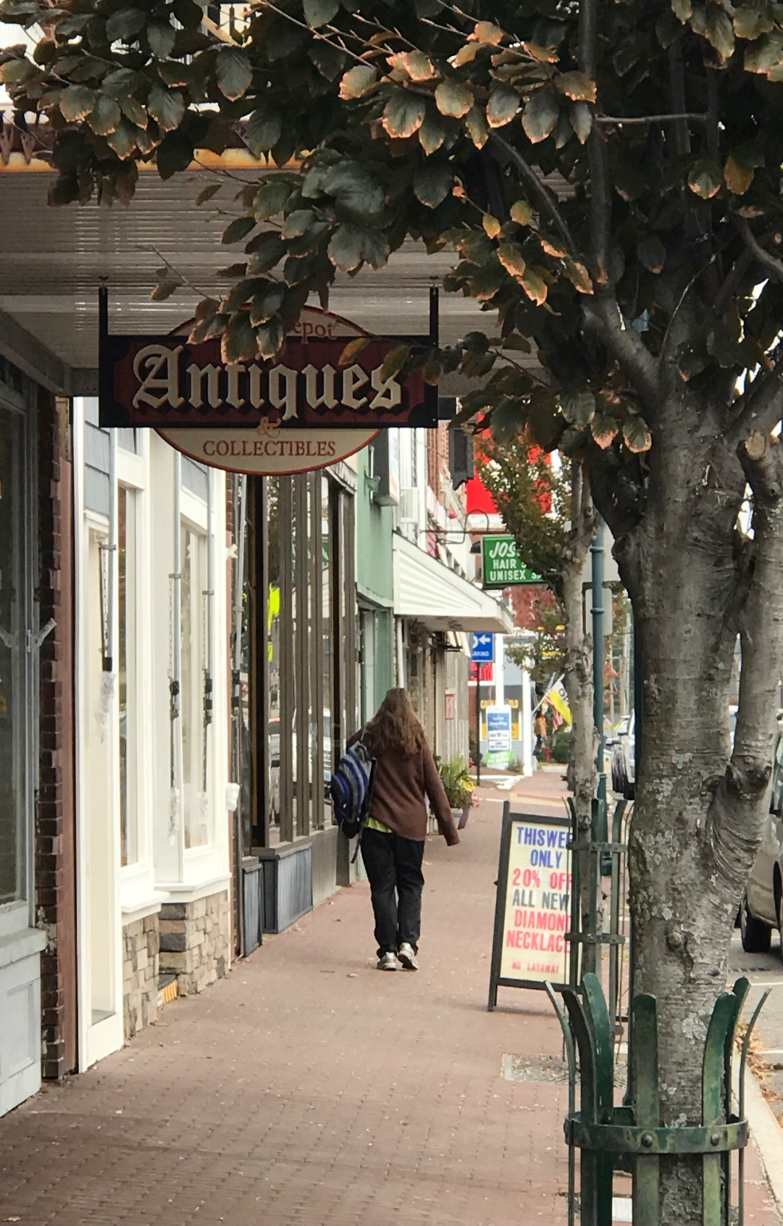
TOP TWELVE (12) KEY RECOMMENDATIONS
Develop and Implement a Downtown Revitalization Plan
Make downtown a destination
Improve walking, biking
Improve streetscape
More restaurants & retail
More outdoor seating
Better parking options
Support visual and performing arts
Revitalize Hood Pond/Park
Connect to Crystal Ave.
LAND USE DISTRICTS AND STANDARDS
FOR AREAS WITHIN THE JURISDICTION OF THE MAINE LAND USE PLANNING COMMISSION
Notes:
Downtown Vitality:
Housing affordable to middle class and artists
Parking
Preservation of scale and historic features in development and redevelopment – need tools
Corridor areas -- Preserve Portsmouth’s character while guiding desirable change
Create a vision for each corridor being mindful of the distinct character of each
EXAMPLES
Supporting a diverse community is primarily about providing affordable housing
Resource protection and sustainability with regard to historic resources, natural resources and climate change

Slide 18
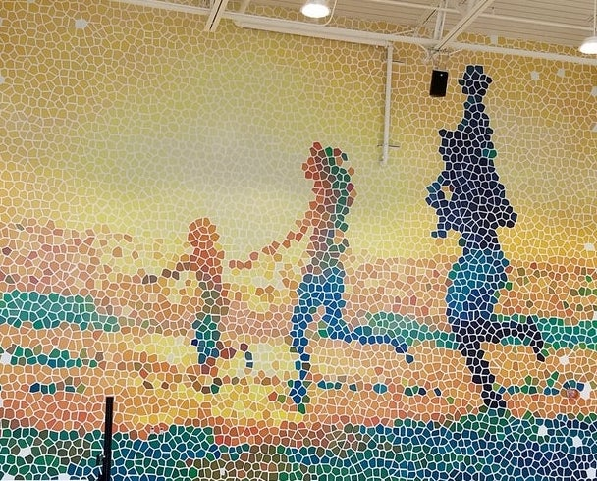
TOP TWELVE (12) KEY RECOMMENDATIONS
Complete a feasibility study for a Community Center
Create a multi-generational opportunity for community gathering
Space for programming for increasing population of older adults
Space for teens, homeschoolers, social clubs, etc.
Recreation
Art center
Involve MGCC, Parks & Recreation, Boys & Girls Club and other relevant partners
LAND USE DISTRICTS AND STANDARDS
FOR AREAS WITHIN THE JURISDICTION OF THE MAINE LAND USE PLANNING COMMISSION
Notes:
Downtown Vitality:
Housing affordable to middle class and artists
Parking
Preservation of scale and historic features in development and redevelopment – need tools
Corridor areas -- Preserve Portsmouth’s character while guiding desirable change
Create a vision for each corridor being mindful of the distinct character of each
EXAMPLES
Supporting a diverse community is primarily about providing affordable housing
Resource protection and sustainability with regard to historic resources, natural resources and climate change

Slide 19
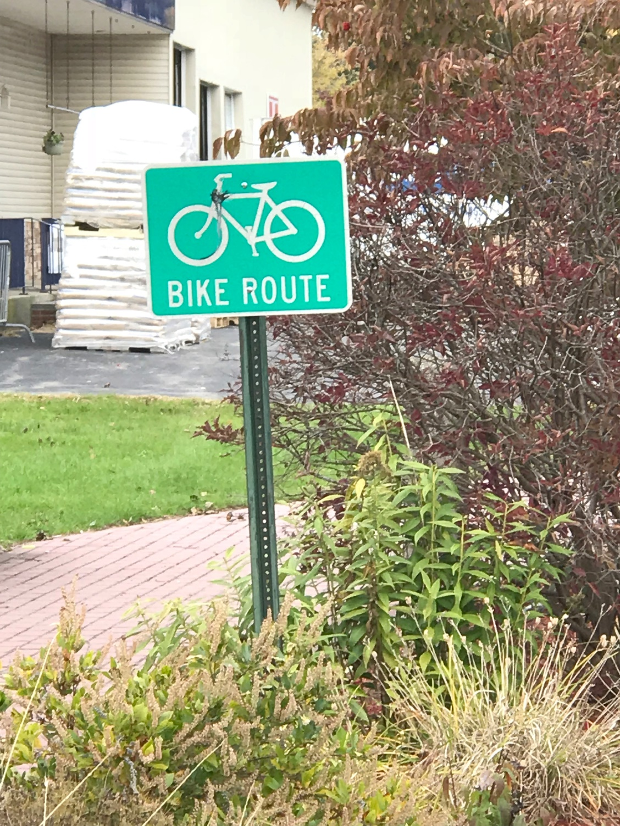
TOP TWELVE (12) KEY RECOMMENDATIONS
Design and plan a town-wide pedestrian and bike network
Create a safe and pleasant interconnected system for walking and biking. This will:
Promote the downtown
Promote history
Market Derry as open for business
Attract young adults
Support older adults
Improve transportation
Expand opportunities for recreation
Improve health and wellness
Mitigate impacts of climate change
LAND USE DISTRICTS AND STANDARDS
FOR AREAS WITHIN THE JURISDICTION OF THE MAINE LAND USE PLANNING COMMISSION
Notes:
Downtown Vitality:
Housing affordable to middle class and artists
Parking
Preservation of scale and historic features in development and redevelopment – need tools
Corridor areas -- Preserve Portsmouth’s character while guiding desirable change
Create a vision for each corridor being mindful of the distinct character of each
EXAMPLES
Supporting a diverse community is primarily about providing affordable housing
Resource protection and sustainability with regard to historic resources, natural resources and climate change

Slide 20

TOP TWELVE (12) KEY RECOMMENDATIONS
Support older adults who wish to age in place
Provide supports that allow people who wish to stay in their home and/or community to do so by providing access to:
  Appropriate and affordable housing choices
  Transportation
  Recreation
  Socialization
  Heath and wellness
LAND USE DISTRICTS AND STANDARDS
FOR AREAS WITHIN THE JURISDICTION OF THE MAINE LAND USE PLANNING COMMISSION
Notes:
Downtown Vitality:
Housing affordable to middle class and artists
Parking
Preservation of scale and historic features in development and redevelopment – need tools
Corridor areas -- Preserve Portsmouth’s character while guiding desirable change
Create a vision for each corridor being mindful of the distinct character of each
EXAMPLES
Supporting a diverse community is primarily about providing affordable housing
Resource protection and sustainability with regard to historic resources, natural resources and climate change

Slide 21
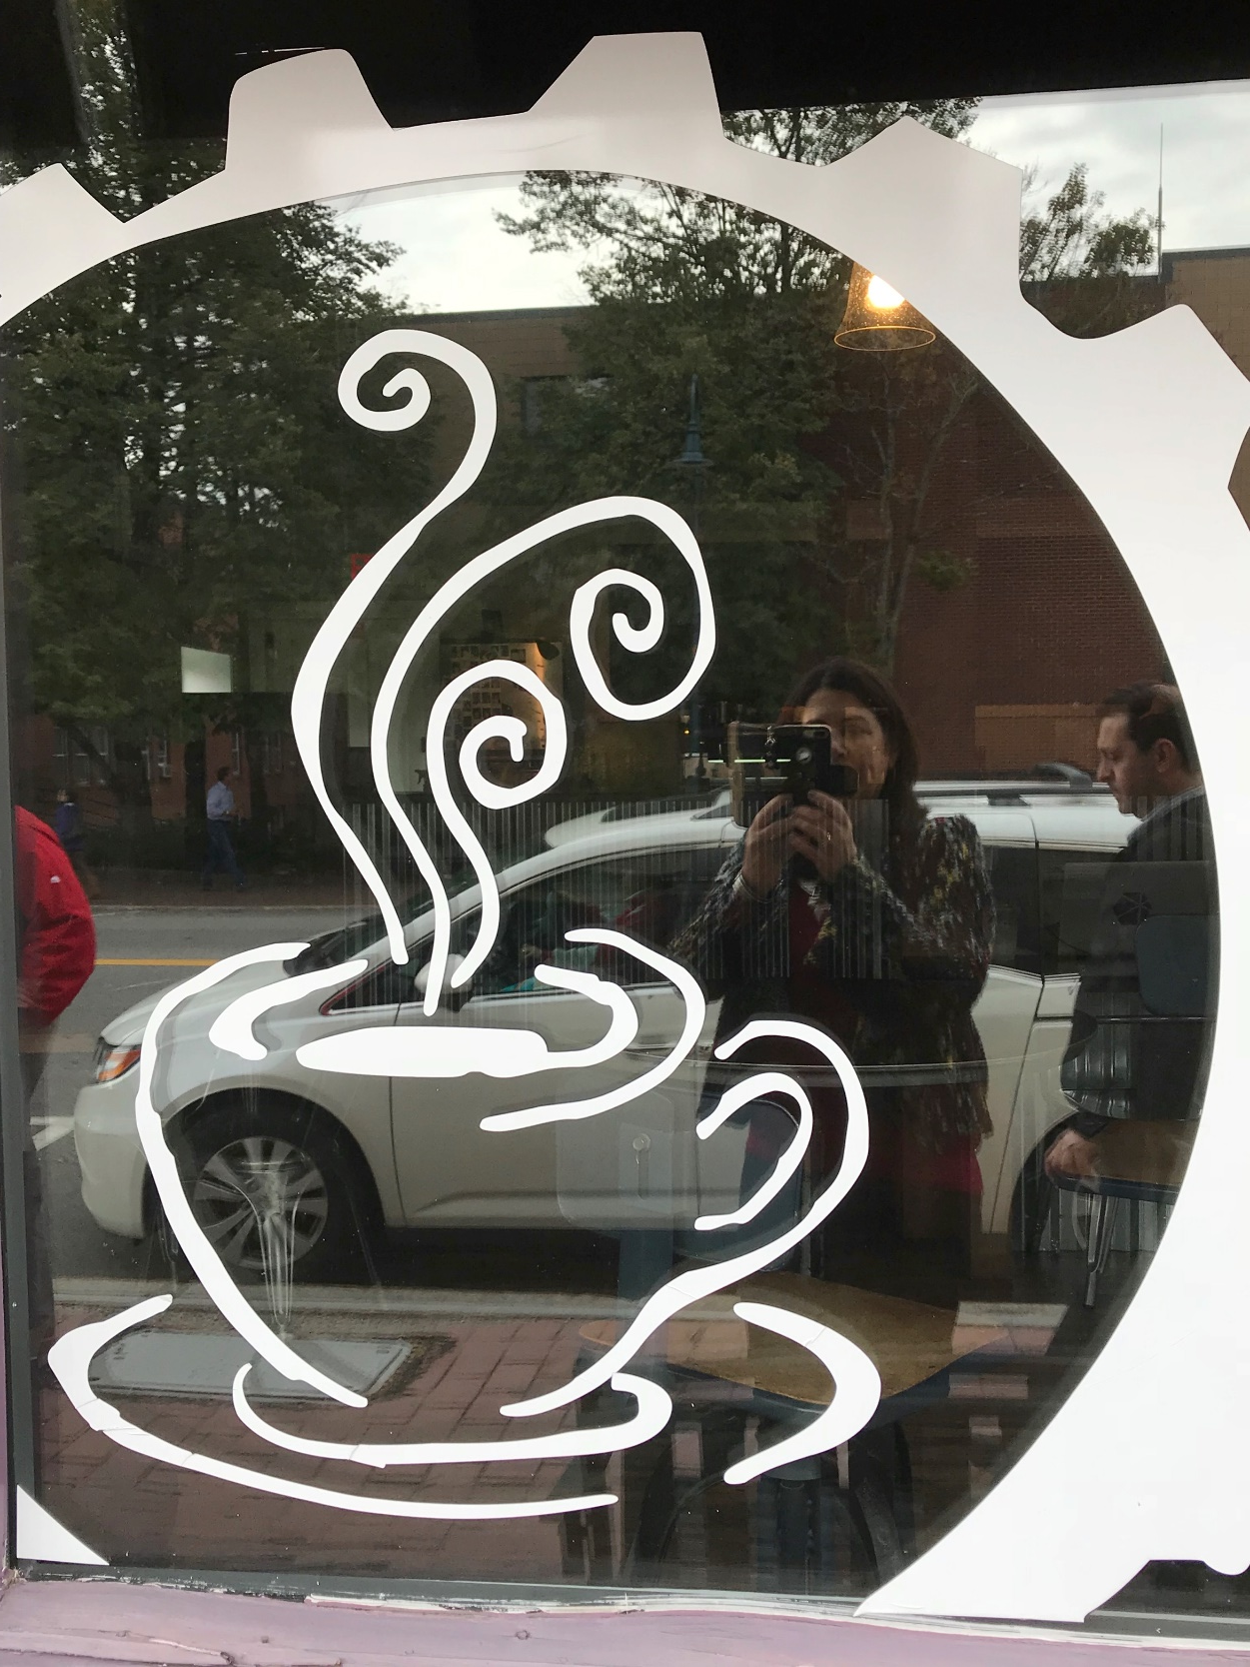
TOP TWELVE (12) KEY RECOMMENDATIONS
Attract young adults to live in Town
Attract youth to bring youthful energy, fill jobs and add to the tax base
Support visual and performing arts
Improve walkability , bikeability, trails and recreation
Promote green initiatives
Create opportunities for employment
Increase downtown vitality
  Breweries, coffee shops
  Live music events
LAND USE DISTRICTS AND STANDARDS
FOR AREAS WITHIN THE JURISDICTION OF THE MAINE LAND USE PLANNING COMMISSION
Notes:
Downtown Vitality:
Housing affordable to middle class and artists
Parking
Preservation of scale and historic features in development and redevelopment – need tools
Corridor areas -- Preserve Portsmouth’s character while guiding desirable change
Create a vision for each corridor being mindful of the distinct character of each
EXAMPLES
Supporting a diverse community is primarily about providing affordable housing
Resource protection and sustainability with regard to historic resources, natural resources and climate change

Slide 22
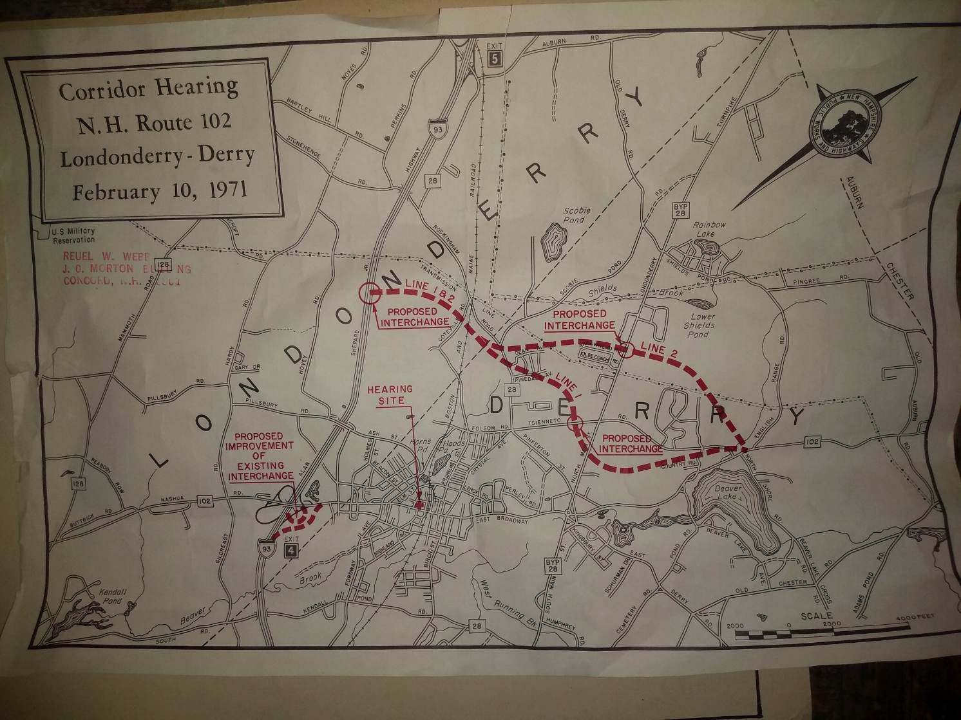
TOP TWELVE (12) KEY RECOMMENDATIONS
Develop a Vision and Plan for Exit 4A Gateway
An opportunity to create a new gateway into Town
Create mixed use zones
Encourage infill development
Develop Entertainment District
Relocate Police Department
Provide infrastructure for safe walking and biking
LAND USE DISTRICTS AND STANDARDS
FOR AREAS WITHIN THE JURISDICTION OF THE MAINE LAND USE PLANNING COMMISSION
Notes:
Downtown Vitality:
Housing affordable to middle class and artists
Parking
Preservation of scale and historic features in development and redevelopment – need tools
Corridor areas -- Preserve Portsmouth’s character while guiding desirable change
Create a vision for each corridor being mindful of the distinct character of each
EXAMPLES
Supporting a diverse community is primarily about providing affordable housing
Resource protection and sustainability with regard to historic resources, natural resources and climate change

Slide 23
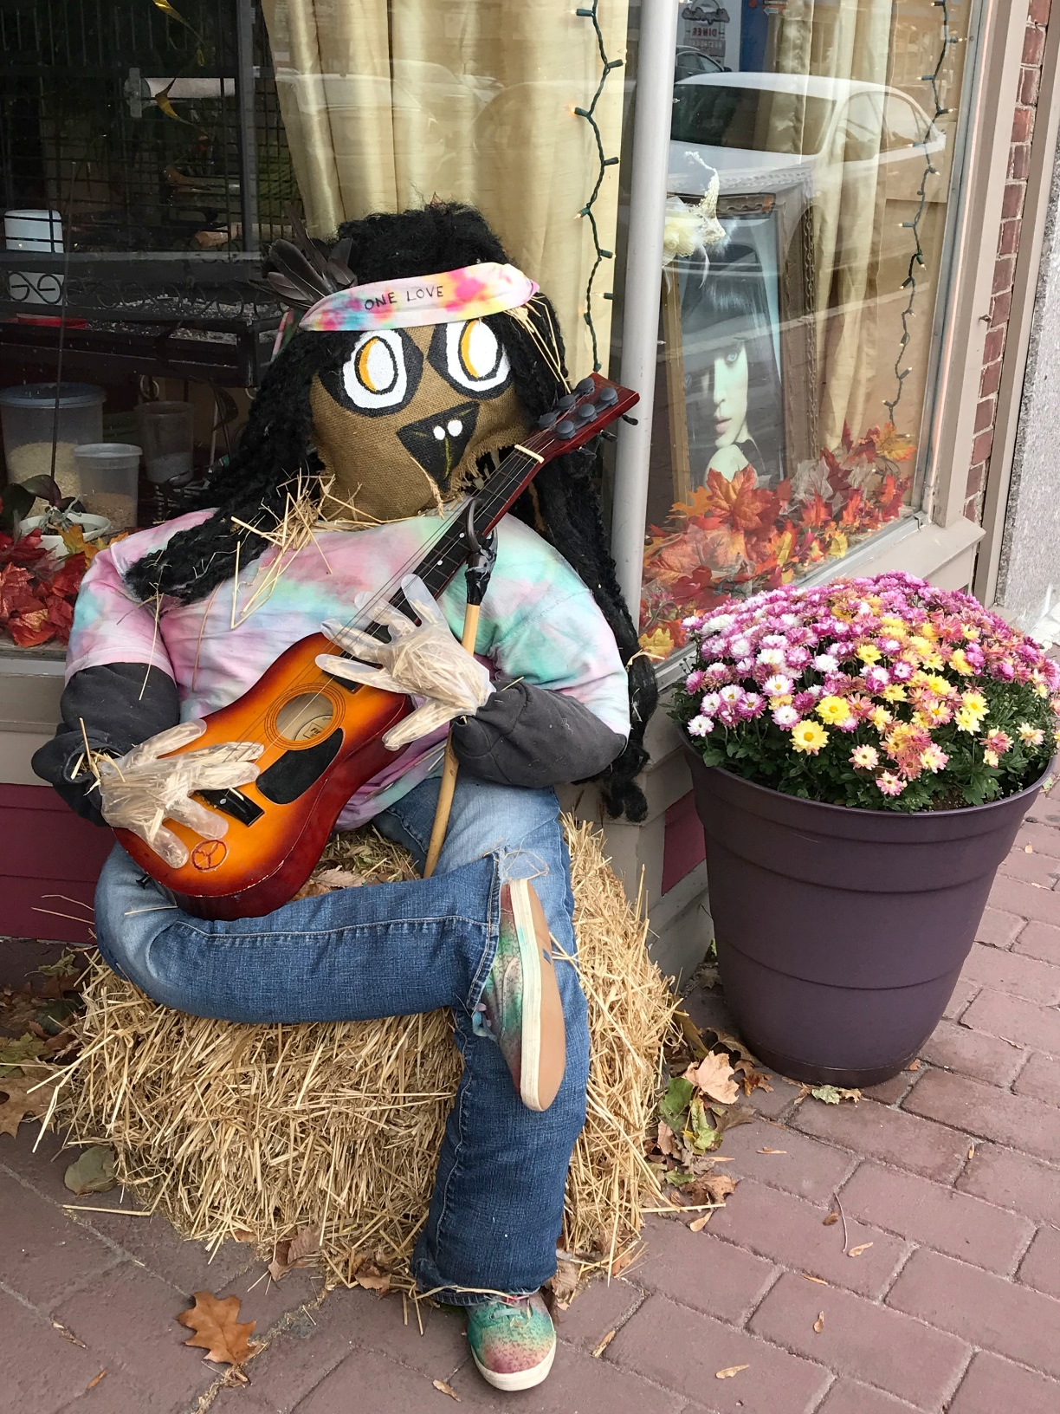
TOP TWELVE (12) KEY RECOMMENDATIONS
Develop a Strategic Plan for Cultural District
An opportunity to create and fund improvements to the Downtown
Involve business owners in creating a shared vision for the downtown
Develop marketing materials
Connect existing cultural venues to restaurants and breweries
Encourage additional performing and visual arts
LAND USE DISTRICTS AND STANDARDS
FOR AREAS WITHIN THE JURISDICTION OF THE MAINE LAND USE PLANNING COMMISSION
Notes:
Downtown Vitality:
Housing affordable to middle class and artists
Parking
Preservation of scale and historic features in development and redevelopment – need tools
Corridor areas -- Preserve Portsmouth’s character while guiding desirable change
Create a vision for each corridor being mindful of the distinct character of each
EXAMPLES
Supporting a diverse community is primarily about providing affordable housing
Resource protection and sustainability with regard to historic resources, natural resources and climate change

Slide 24
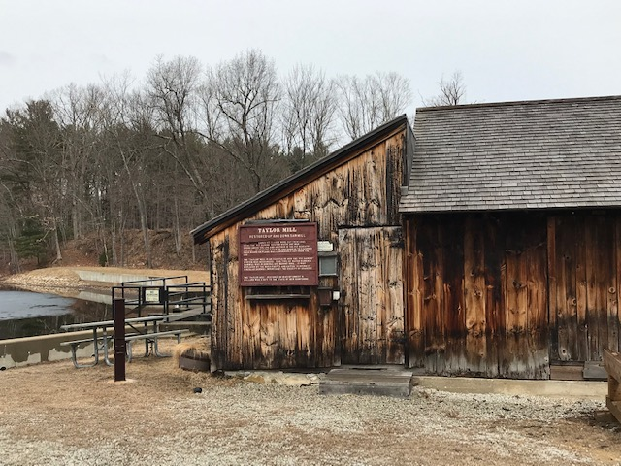

TOP TWELVE (12) KEY RECOMMENDATIONS
Develop a plan to promote heritage tourism
An opportunity to promote Derry’s past to increase community pride and economic development
Preserve historic buildings
Promote legacy stories
  Robert Frost
  Alan Shepard
  “Nations First potato”
  H.P. Hood & Sons
  Londonderry Linen
LAND USE DISTRICTS AND STANDARDS
FOR AREAS WITHIN THE JURISDICTION OF THE MAINE LAND USE PLANNING COMMISSION
Notes:
Downtown Vitality:
Housing affordable to middle class and artists
Parking
Preservation of scale and historic features in development and redevelopment – need tools
Corridor areas -- Preserve Portsmouth’s character while guiding desirable change
Create a vision for each corridor being mindful of the distinct character of each
EXAMPLES
Supporting a diverse community is primarily about providing affordable housing
Resource protection and sustainability with regard to historic resources, natural resources and climate change

Slide 25
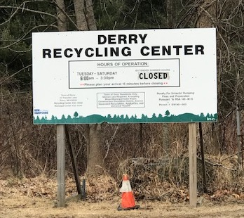
TOP TWELVE (12) KEY RECOMMENDATIONS
Develop a Climate Change Adaptation & Resiliency Plan
Be more sustainable
Promote renewable energy sources
Apply smart growth land use policies
Prepare for resilience to extreme weather conditions
Continue to recycle
LAND USE DISTRICTS AND STANDARDS
FOR AREAS WITHIN THE JURISDICTION OF THE MAINE LAND USE PLANNING COMMISSION
Notes:
Downtown Vitality:
Housing affordable to middle class and artists
Parking
Preservation of scale and historic features in development and redevelopment – need tools
Corridor areas -- Preserve Portsmouth’s character while guiding desirable change
Create a vision for each corridor being mindful of the distinct character of each
EXAMPLES
Supporting a diverse community is primarily about providing affordable housing
Resource protection and sustainability with regard to historic resources, natural resources and climate change

Slide 26
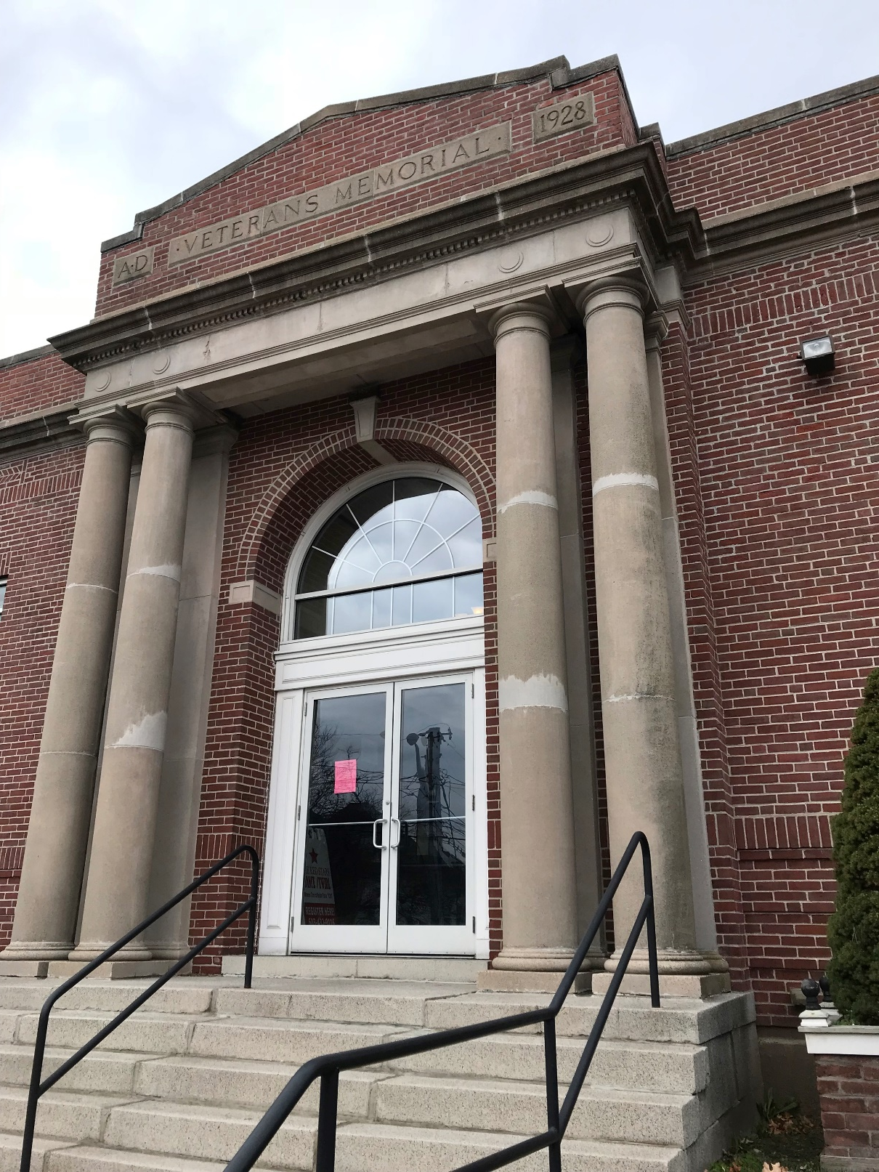
TOP TWELVE (12) KEY RECOMMENDATIONS
Encourage more community gathering
Support Derry’s small-town feeling
Organize events and activities
Provide opportunities for recreation (indoors & outdoors)
Provide opportunities for family entertainment
Encourage more third places oriented to young adults
Provide more opportunities for inter-generational interaction
LAND USE DISTRICTS AND STANDARDS
FOR AREAS WITHIN THE JURISDICTION OF THE MAINE LAND USE PLANNING COMMISSION
Notes:
Downtown Vitality:
Housing affordable to middle class and artists
Parking
Preservation of scale and historic features in development and redevelopment – need tools
Corridor areas -- Preserve Portsmouth’s character while guiding desirable change
Create a vision for each corridor being mindful of the distinct character of each
EXAMPLES
Supporting a diverse community is primarily about providing affordable housing
Resource protection and sustainability with regard to historic resources, natural resources and climate change

Slide 27
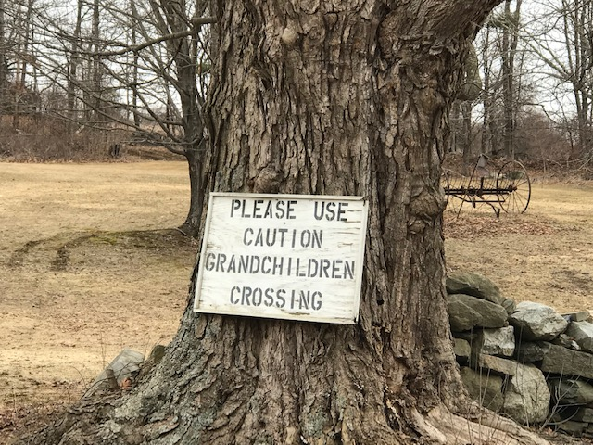
TOP TWELVE (12) KEY RECOMMENDATIONS
Develop a Health & Wellness Campaign
”Let’s Move Derry”
Promote healthy lifestyle choices
  Healthy eating, local food
  Encourage walking, biking
  Reduce substance abuse
  Reduce isolation of seniors and others
Focus on both physical and mental health
LAND USE DISTRICTS AND STANDARDS
FOR AREAS WITHIN THE JURISDICTION OF THE MAINE LAND USE PLANNING COMMISSION
Notes:
Downtown Vitality:
Housing affordable to middle class and artists
Parking
Preservation of scale and historic features in development and redevelopment – need tools
Corridor areas -- Preserve Portsmouth’s character while guiding desirable change
Create a vision for each corridor being mindful of the distinct character of each
EXAMPLES
Supporting a diverse community is primarily about providing affordable housing
Resource protection and sustainability with regard to historic resources, natural resources and climate change

Slide 28
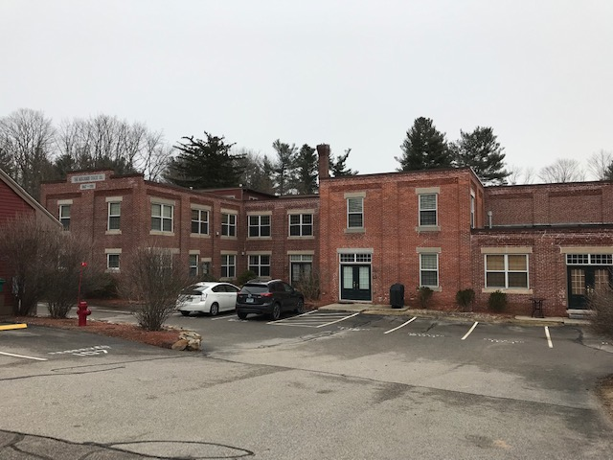
TOP TWELVE (12) KEY RECOMMENDATIONS
Explore alternative housing options
Provide older and younger adults more housing options
Micro units/tiny houses
Live-work spaces
Walkable neighborhoods
LAND USE DISTRICTS AND STANDARDS
FOR AREAS WITHIN THE JURISDICTION OF THE MAINE LAND USE PLANNING COMMISSION
Notes:
Downtown Vitality:
Housing affordable to middle class and artists
Parking
Preservation of scale and historic features in development and redevelopment – need tools
Corridor areas -- Preserve Portsmouth’s character while guiding desirable change
Create a vision for each corridor being mindful of the distinct character of each
EXAMPLES
Supporting a diverse community is primarily about providing affordable housing
Resource protection and sustainability with regard to historic resources, natural resources and climate change

Slide 29
KEY CAPITAL EXPENDITURES
Relocating the Police Headquarters to mitigate impacts of Exit 4A
Upgrading the Fire Department stations facilities
Additional recreational facilities
Intergenerational Recreation and Community Center
Additional services and facilities for older adults
Retrofitting municipal facilities with renewable energy sources & other energy reduction measures
Walking/Biking Infrastructure (sidewalks, crosswalks, bike paths, Rail Trail)
Streetscape improvements to Downtown
LAND USE DISTRICTS AND STANDARDS
FOR AREAS WITHIN THE JURISDICTION OF THE MAINE LAND USE PLANNING COMMISSION
Notes:
Downtown Vitality:
Housing affordable to middle class and artists
Parking
Preservation of scale and historic features in development and redevelopment – need tools
Corridor areas -- Preserve Portsmouth’s character while guiding desirable change
Create a vision for each corridor being mindful of the distinct character of each
EXAMPLES
Supporting a diverse community is primarily about providing affordable housing
Resource protection and sustainability with regard to historic resources, natural resources and climate change

Slide 30
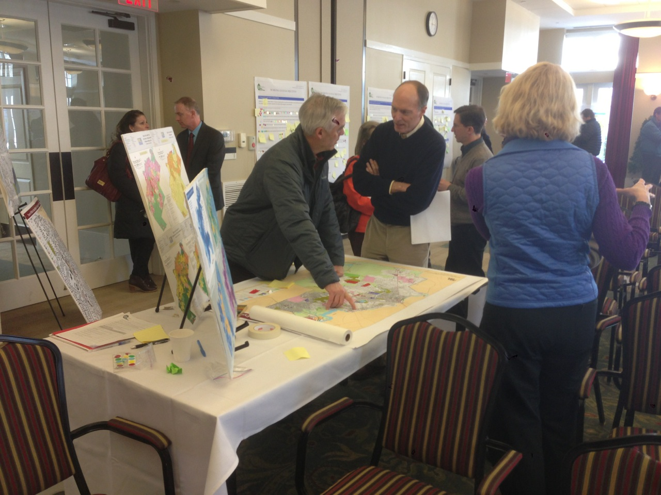
THIS EVENING’S PLAN
REVIEW THE IMPLENTATION PLAN
HOW TO ACHIEVE THE VISION & GOALS
  VISIT THE 6 IMPLEMENTATION STATIONS (approximately 10 minutes per station)
    Review Strategies (and add new ones)
    Identify “low hanging fruit”
    Answer questions regarding implementation
    Prioritize across Goals
  RECONVENE as a Large Group
  (Maybe win the) RAFFLE!!

Slide 31
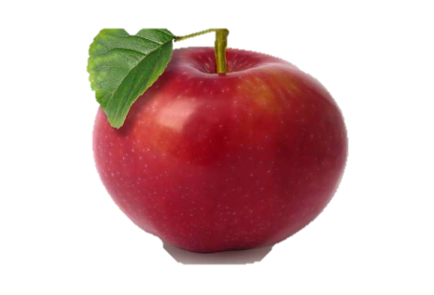
IMPLEMENTATION PLAN
Priority/Timing
“Ripe Apples”
#1: Immediate – 1-5 Years
#2: Intermediate – 5-10 Years
#3: Future (Re-evaluate in 10
Years) – 10-20 Years
Ongoing: Continue to
Support Action already in Progress
“Low-hanging fruit”:
relatively easy, low cost actions that make a difference
IMPORTANT NOTE:
Numbering of action steps does not in any way indicate priority
Responsible parties
and existing resources and partners

Slide 32
MASTER PLAN IMPLEMENTATION STATIONS
GOAL 1: Make Derry a DESTINATION
(Downtown improvements, town character, reputation, history, natural resources)
GOAL 2: Encourage ECONOMIC ACTIVITY
(creative economy, Route 28 South)
GOAL 3: Address the opportunities and challenges posed by EXIT 4 (vision, development/redevelopment)
GOAL 4: Promote Derry as a PLACE TO LIVE
(housing, millennials, senior citizens, transportation, neighborhoods, public facilities and services)
GOAL 5: Promote HEALTH AND WELLNESS
(walking, biking, recreation for all ages, local and healthy food, community gathering, substance abuse)
GOAL 6: Conserve ENERGY and PLAN FOR RESILIENCE
(conserve energy, alternative modes of transportation, sustainable development practices, mitigate impacts of climate change)

Slide 33
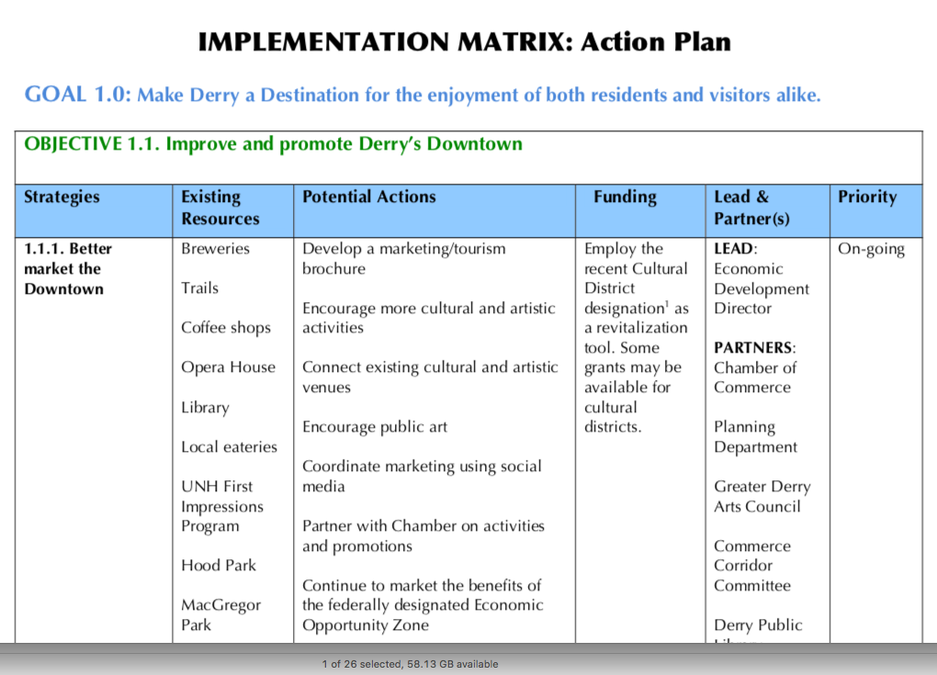
FULL IMPLEMENTATION MATRIX
See DRAFT Report if interested

Slide 34
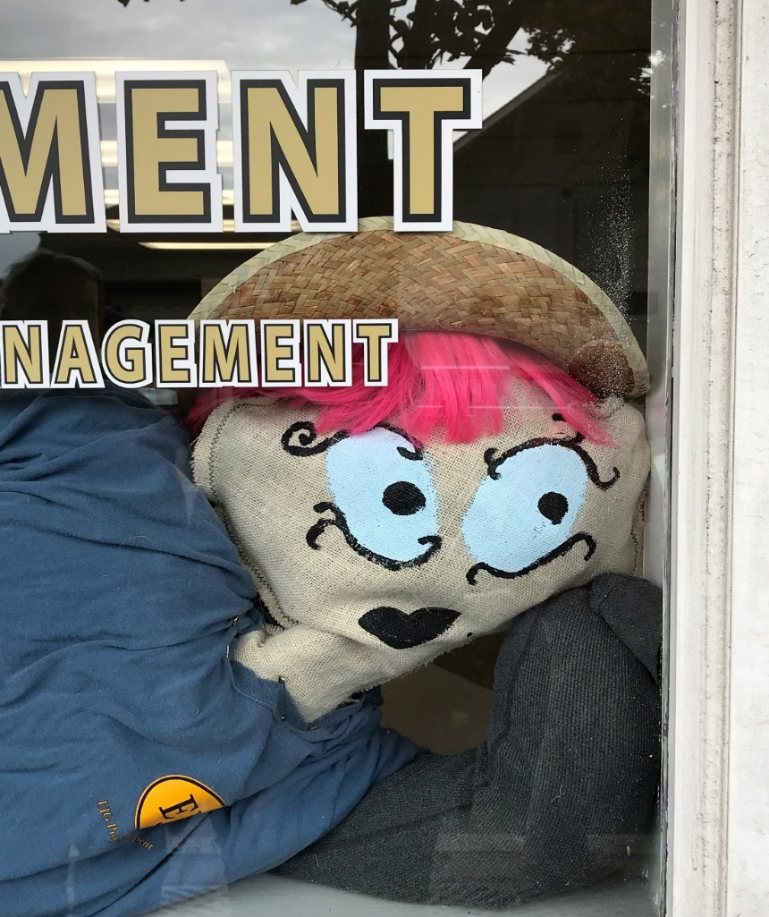
YOUR INPUT
Let us know if you have additional comments
“OTHER” Station

Slide 35


CONSULTANT TEAM
Community Circle

Slide 36

And now for the RAFFLE…
Our way of saying thank you!
Derry Master Plan

