Slide 1
Derry
Community Power
With Standard Power
July 20, 2023
Notes:
Add logo and THEME

Slide 2
Mike Fowler
Director of Public Works
Town of Derry
Robert Hayden
President and CTO
Standard Power
Emily Manns
Community Power Consultant
Standard Power
Welcome

Slide 3
RSA 53 E
Allows municipalities to aggregate retail electric customers
Provides access to competitive markets for supplies of electricity and related energy services
Offers small customers similar opportunities to those available to larger customers, for lower electric costs, reliable service, and secure energy supplies
Encourage cost effective and innovative solutions to local needs with careful consideration of local conditions and opportunities
Purpose

Slide 4
Standard Power
Estimated Electric Savings
$963,322
Hydro Program reimbursements
$137,080

Slide 5
Standard Power
Teamed up with Good Energy LLP in 2020
Providence and six communities in RI, representing 20% of state load
45 programs in Massachusetts, representing 400 million kWh/year
First four New Hampshire programs launched in June with almost 9 cents/kWh savings
Total 20 NH programs launched or in the planning process

Slide 6
What is Community Power?
Municipality procures electricity supply for residents and small businesses.
Delivery, emergency services, and billing all stay with the utility.

Slide 7
Secure Competitive Pricing
Market Timing
Buying Power
Contract Length
+
+

Slide 8
Use and Support Local
Renewable Energy
Notes:
Add Market slide (check theme)

Slide 9
More Benefits
Local control
Consumer protections
Energy planning
Innovative local programs
Education and awareness

Slide 10
Consumer Choices
Third Party Offers
Utility Default Service Supply Rate
New Community Power Program Default Service Rate
Basic product (optional)
Optional product (optional)
100% renewable (optional)
Eligible customers are automatically enrolled in program default unless they opt out. Other customers can opt into the program.

Slide 11
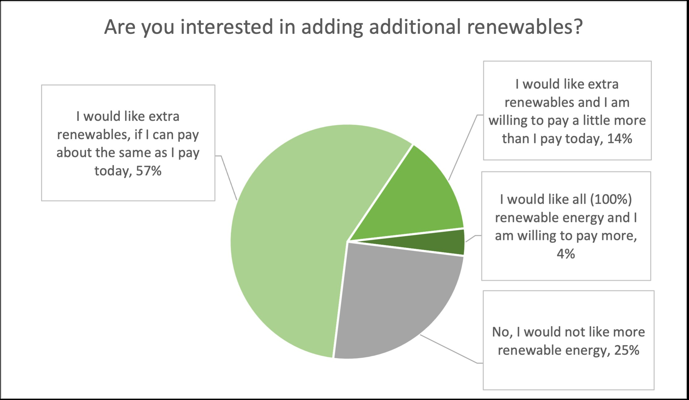
Derry Community Survey 7/19/2023 81 responses

Slide 12
Sample Product Options
Standard/Default
Basic
50%-100%
Adds 5-10% or more Class I RECs
Meets State standards for renewable energy*
Matches 50% and/or 100% of energy use with extra Class I RECs
*New Hampshire RPS in 2023 is 23.4% Renewable Energy Certificates (RECs)

Slide 13
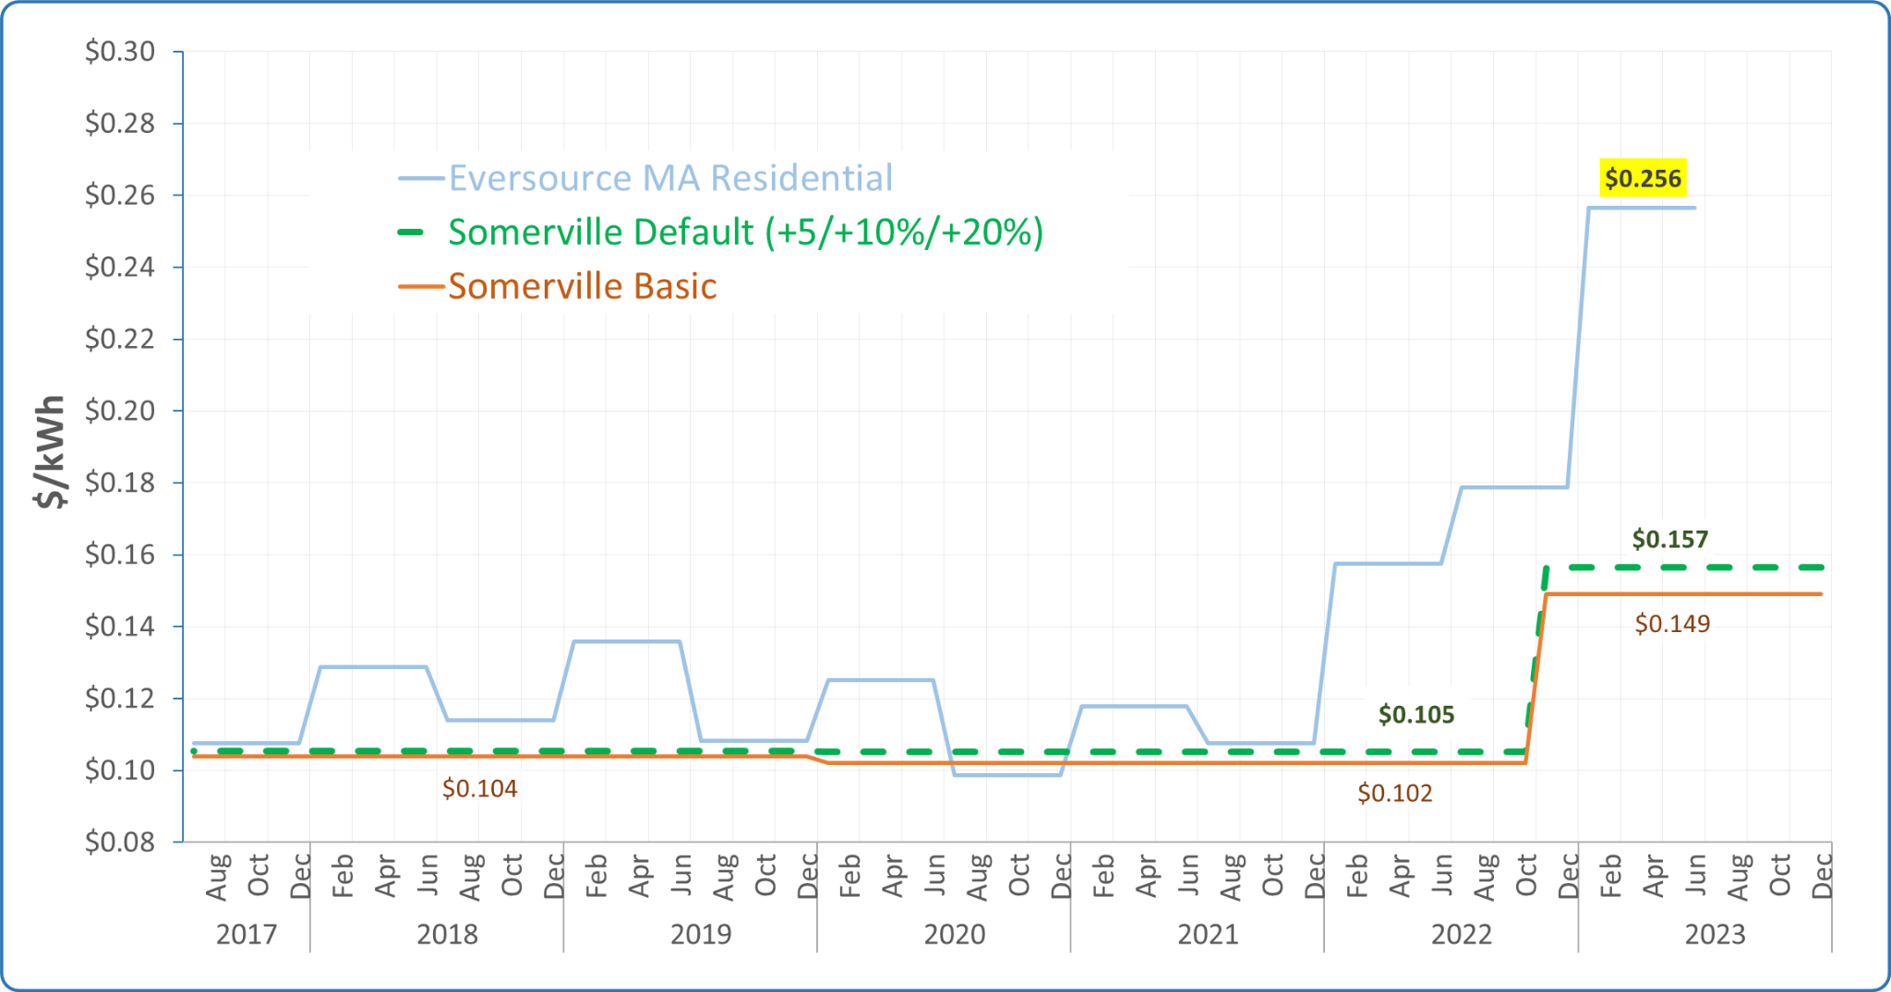
Example: Somerville Community Choice
Disclaimer: Savings cannot be guaranteed, because utility Basic Service prices change every six months for residential customers

Slide 14
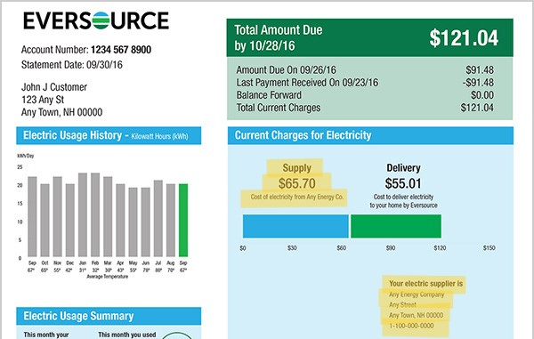

Slide 15
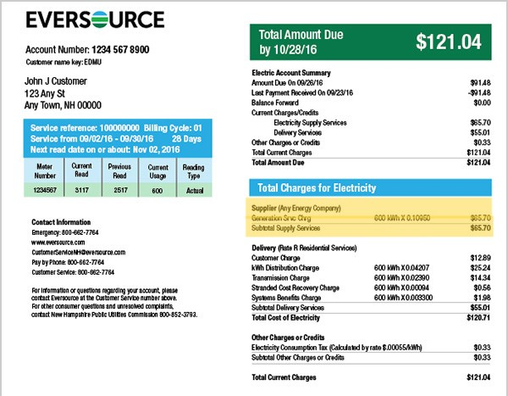

Slide 16
Derry Timeline:
Formed Team
Plan & Approve
Regulatory
Electricity Procurement and Outreach
Launch, Manage + Monitor
Appointed Community Power Committee
Signed MOU to work with Standard Power for no cost or obligation
Draft Community Power Plan with public input
Secure local approval of plan (Town Council)
Submit Plan to Public Utilities Commission for approval
Notify utilities and NHEC of intent to launch program
Competitive process to procure electricity supply
Implement public education and opt-out campaign
Mailing sent to every residential and commercial customer in Derry
Public meeting, dedicated web page and customer support help lines
Launch! Eligible accounts that have not opted out are automatically enrolled
Ongoing customer support, outreach, opt up campaigns, data management and analysis, planning, and more

Slide 17
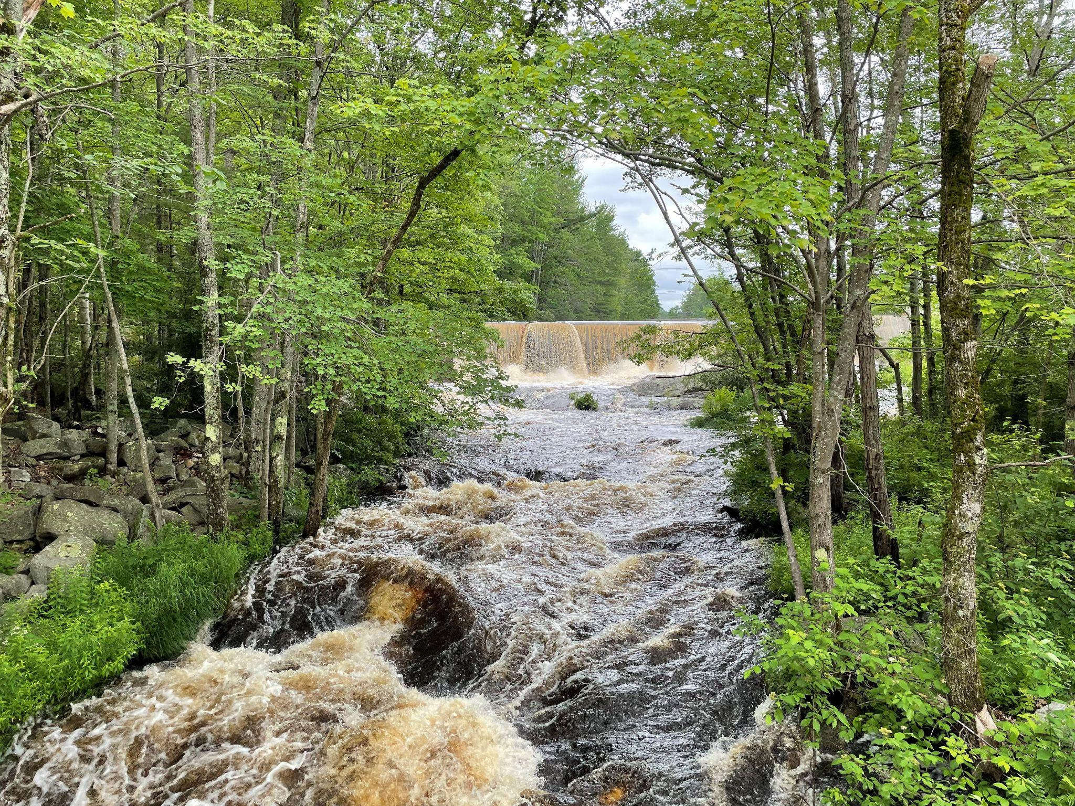
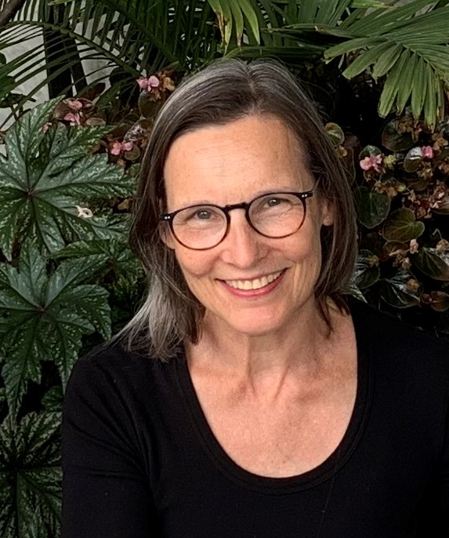
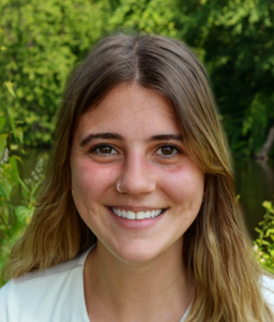
Questions?
Bob Hayden
President and CTO
Standard Power b.hayden@standardpower.com
Emily Manns
Community Power Consultant
Standard Power e.manns@standardpower.com
Theresa MacDowell
t.macdowell@standardpower.com
Notes:
**Add Theresa

Slide 18
Postcard
We added a signature to the postcard to make the invitation to the community meeting more personable. Having someone from the Town show their support for the program also increases the acceptance of it.

Slide 19
Bookmarks & Flyers
Melrose did a trial run handing out bookmarks at events. We’ve now printed 800 bookmarks for them and their opt up numbers are consistently climbing.

Slide 20
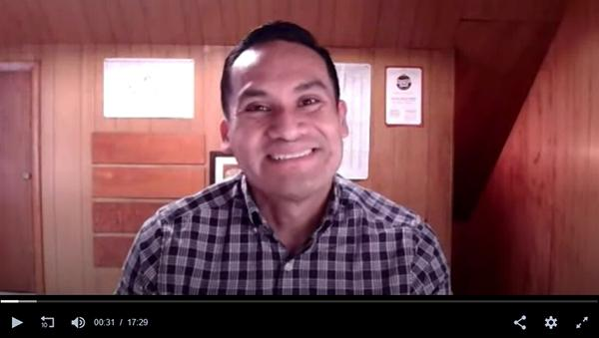
Video Interviews
We recorded 2 informational videos with Waltham City Councilor Vidal, one in English and one En español. The interviews are listed on the website and were shown by WCAC-TV. Both are around 10 minutes in length and cover the basics of the program.

Slide 21
Social Media
We added a nudge reminder for the 100% option into the general social media schedule for the launch period.

Slide 22
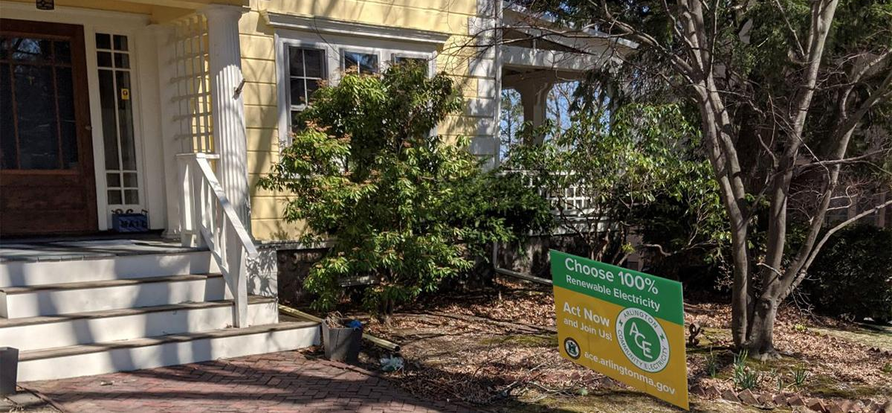
Lawn Signs
Arlington - Our data showed that people who signed up for 100% or 50% products learned about them through word of mouth or signs, so we printed signs for Arlington and asked the 100ers to post them. We got 36 lawn sign requests in 1 week.

