Slide 1

FY 22 Goals Workshop
June 22, 2021
Derry Opera House

Slide 2

FY 21 Goals - Status

Slide 3
FY 21 Goals - Status

Slide 4
FY 22 Goals?

Slide 5

Recreation Bond
Authorized $1.8M for improvements
With UNH, developed Recreation Master Plan:
Phase I focus:
Hood Park Revitalization
Derry Rail Trail – Phase I
Alexander – Carr Park Improvements
West Running Brook Multipurpose Field

Slide 6
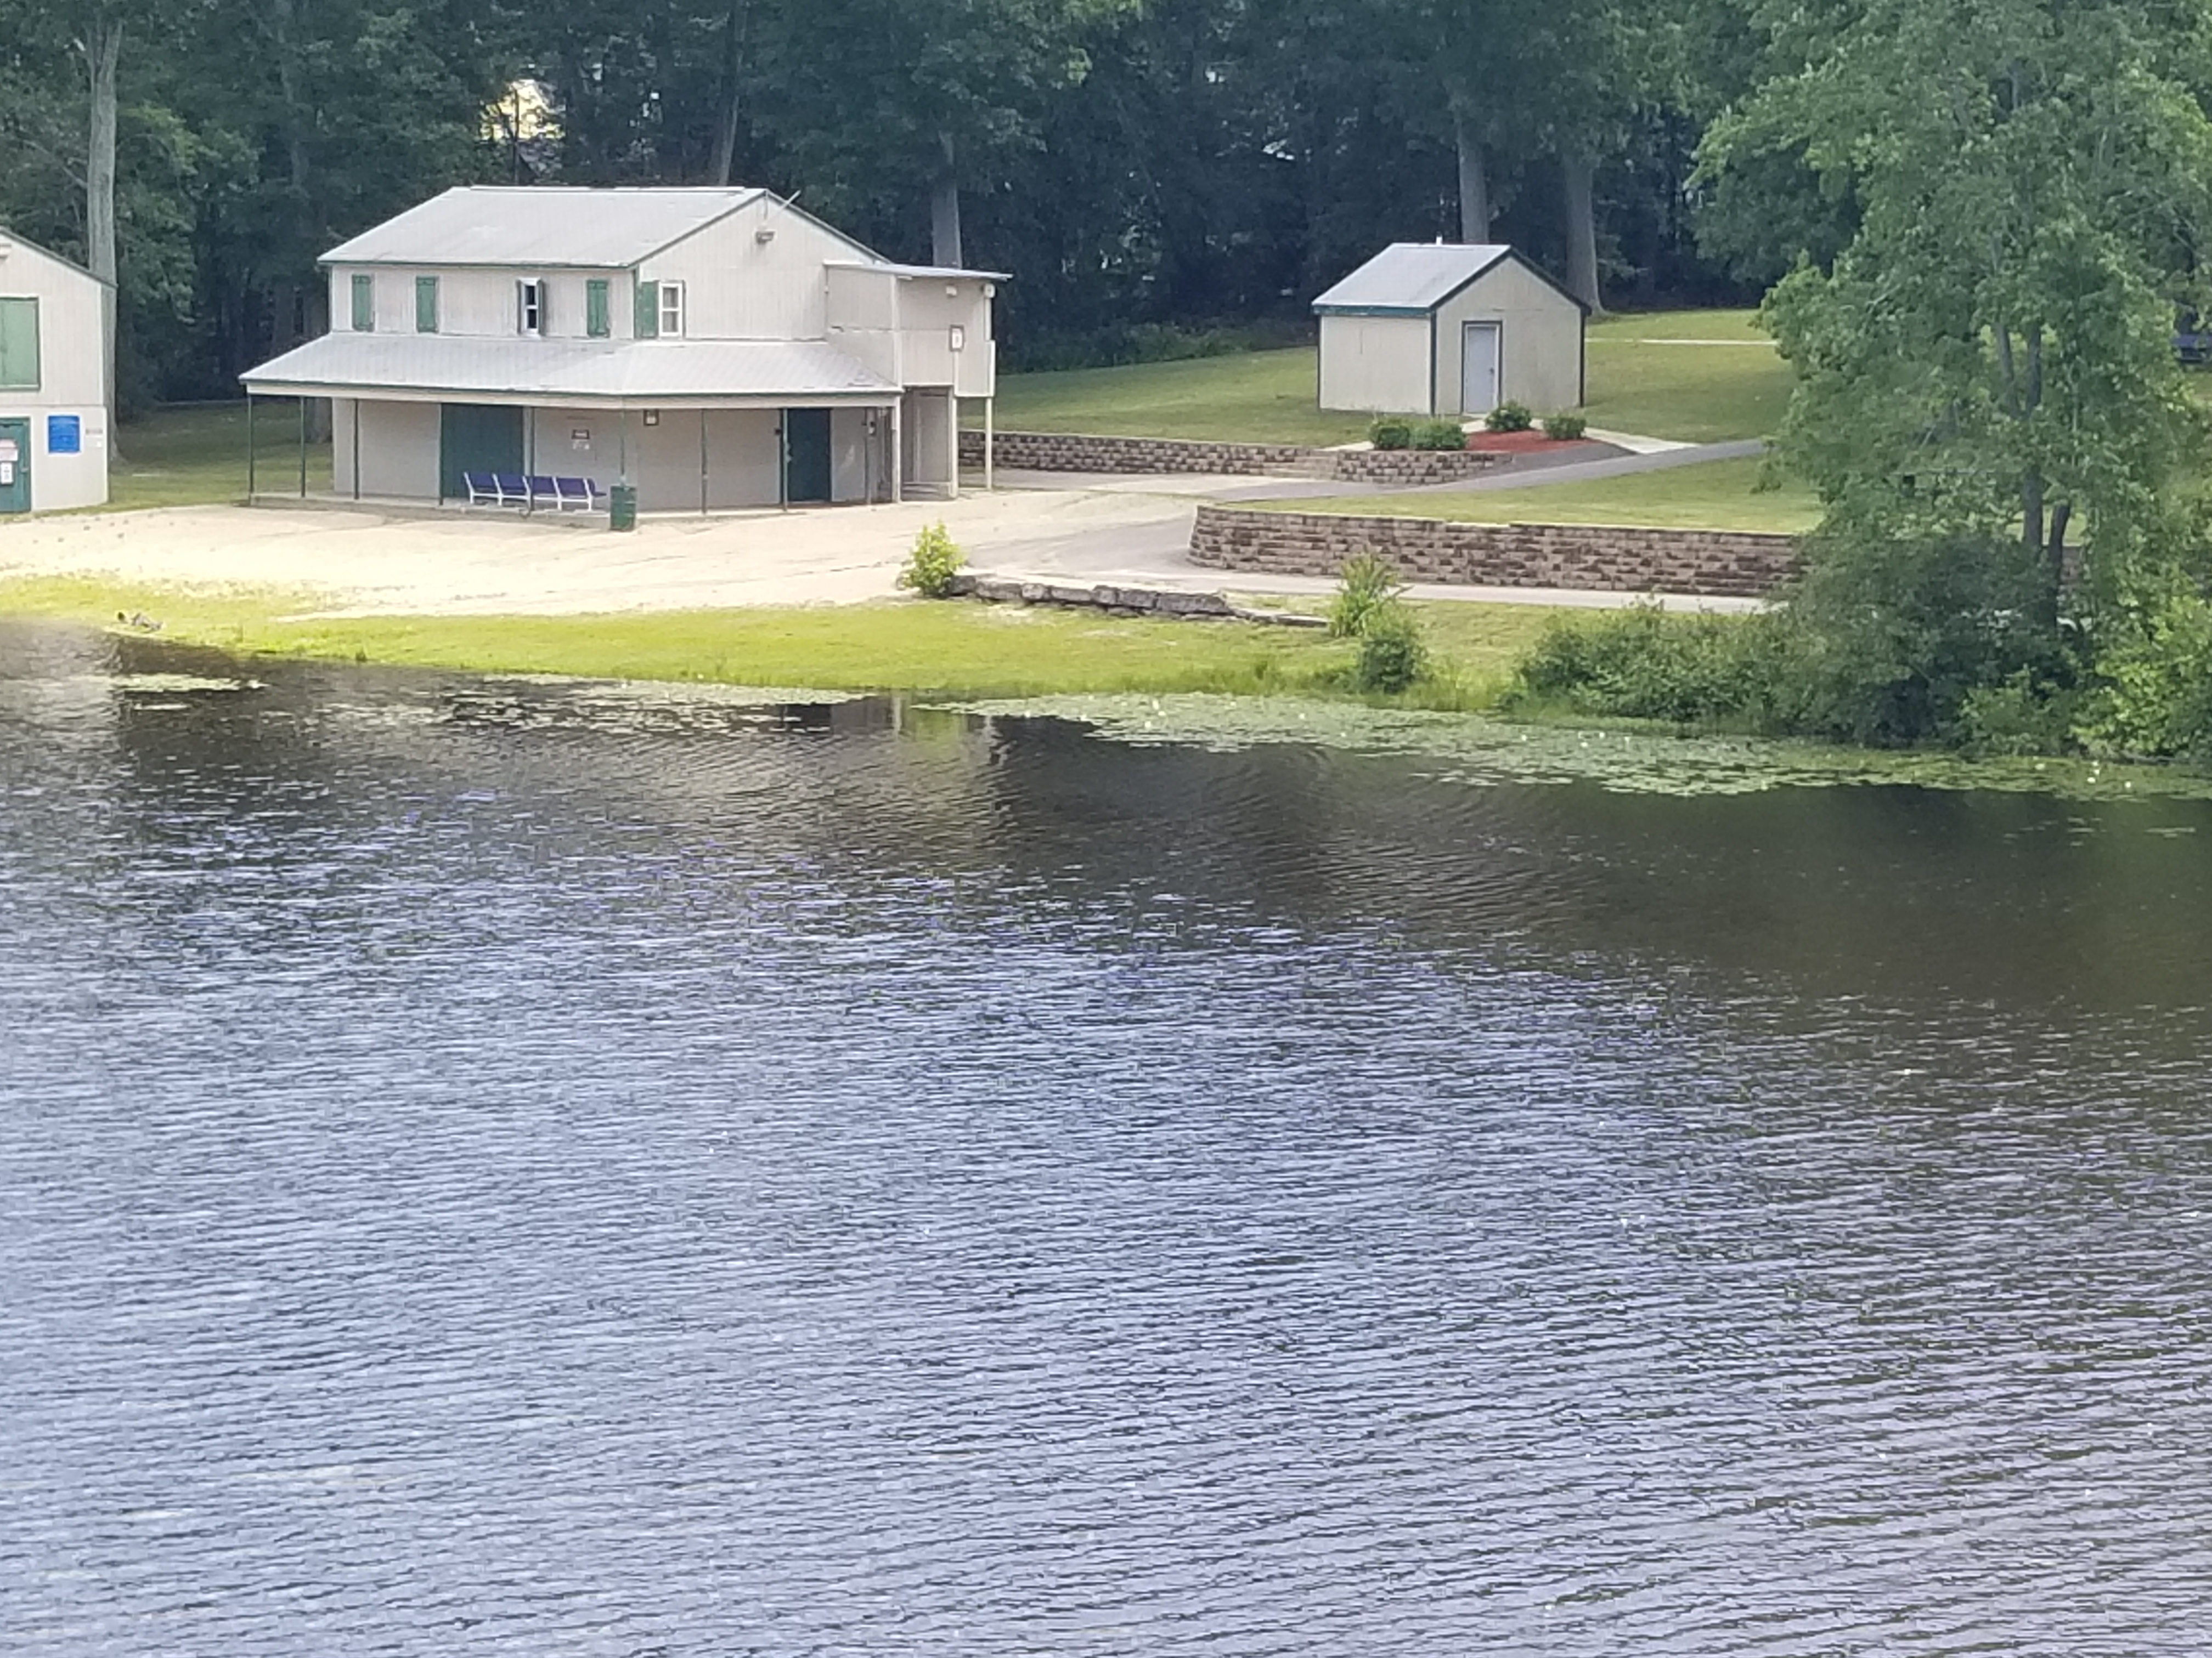
Hood Park Revitalization
Steering Committee Report presented to Council on February 16
Committee to remain to develop nature areas/arboretum
Staff reported out on implementation on March 26
18 goals presented for implementation over three phases
Final Decision required on funding allocation between Recreation Bond and DCC TIF Improvement Fund

Slide 7
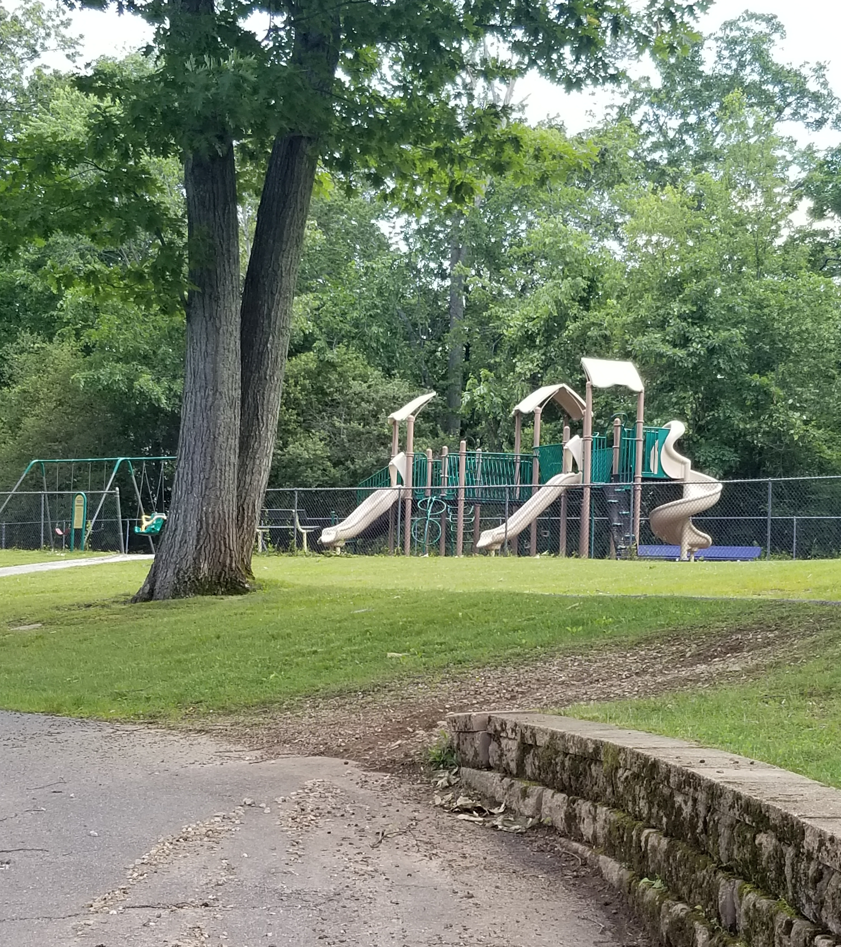
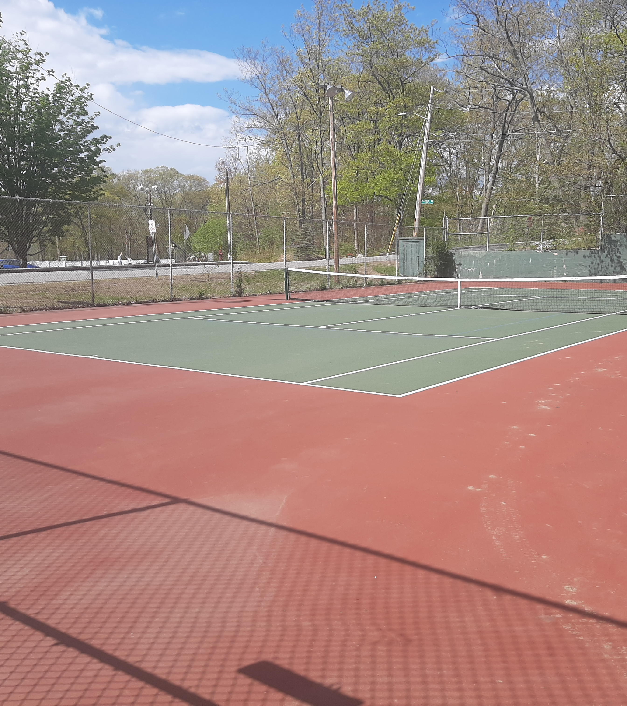
Hood Park
Continuous Improvement

Slide 8
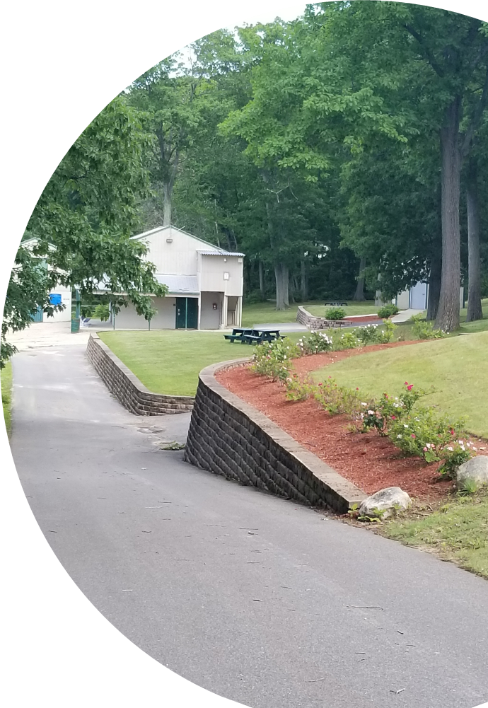
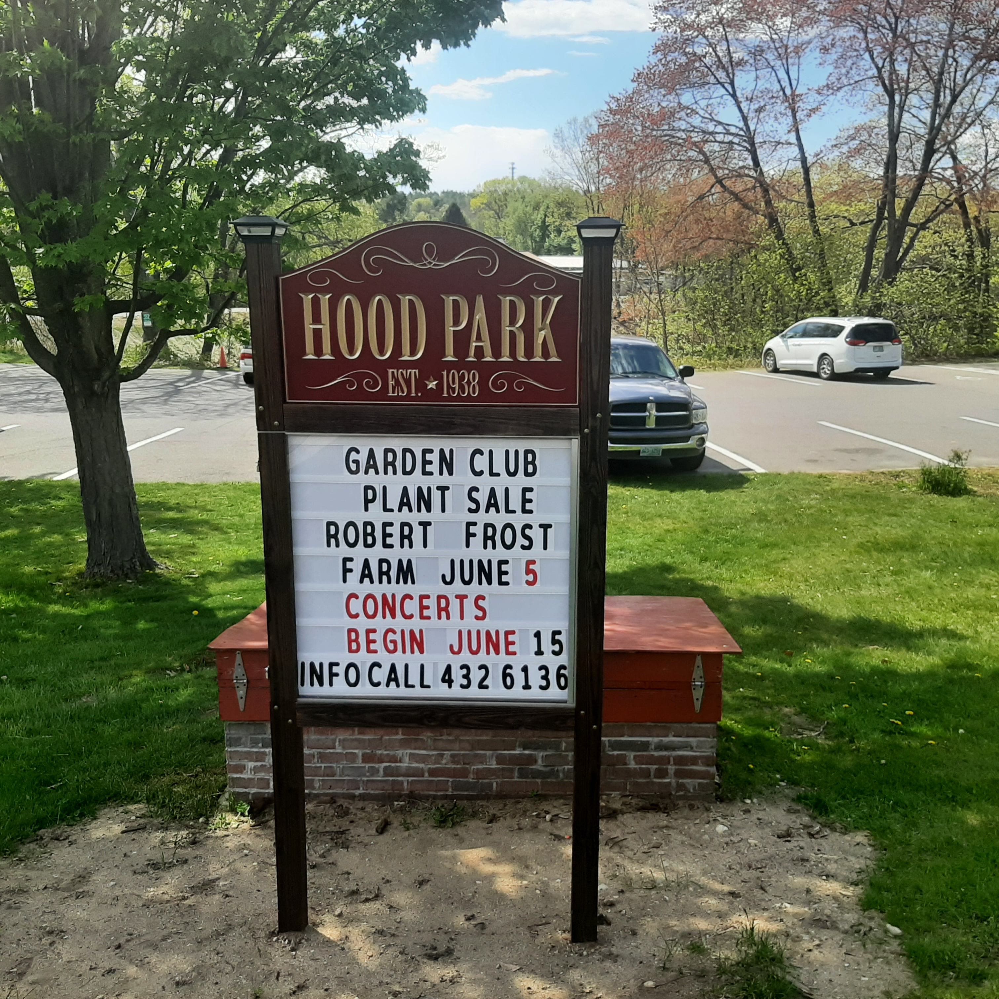
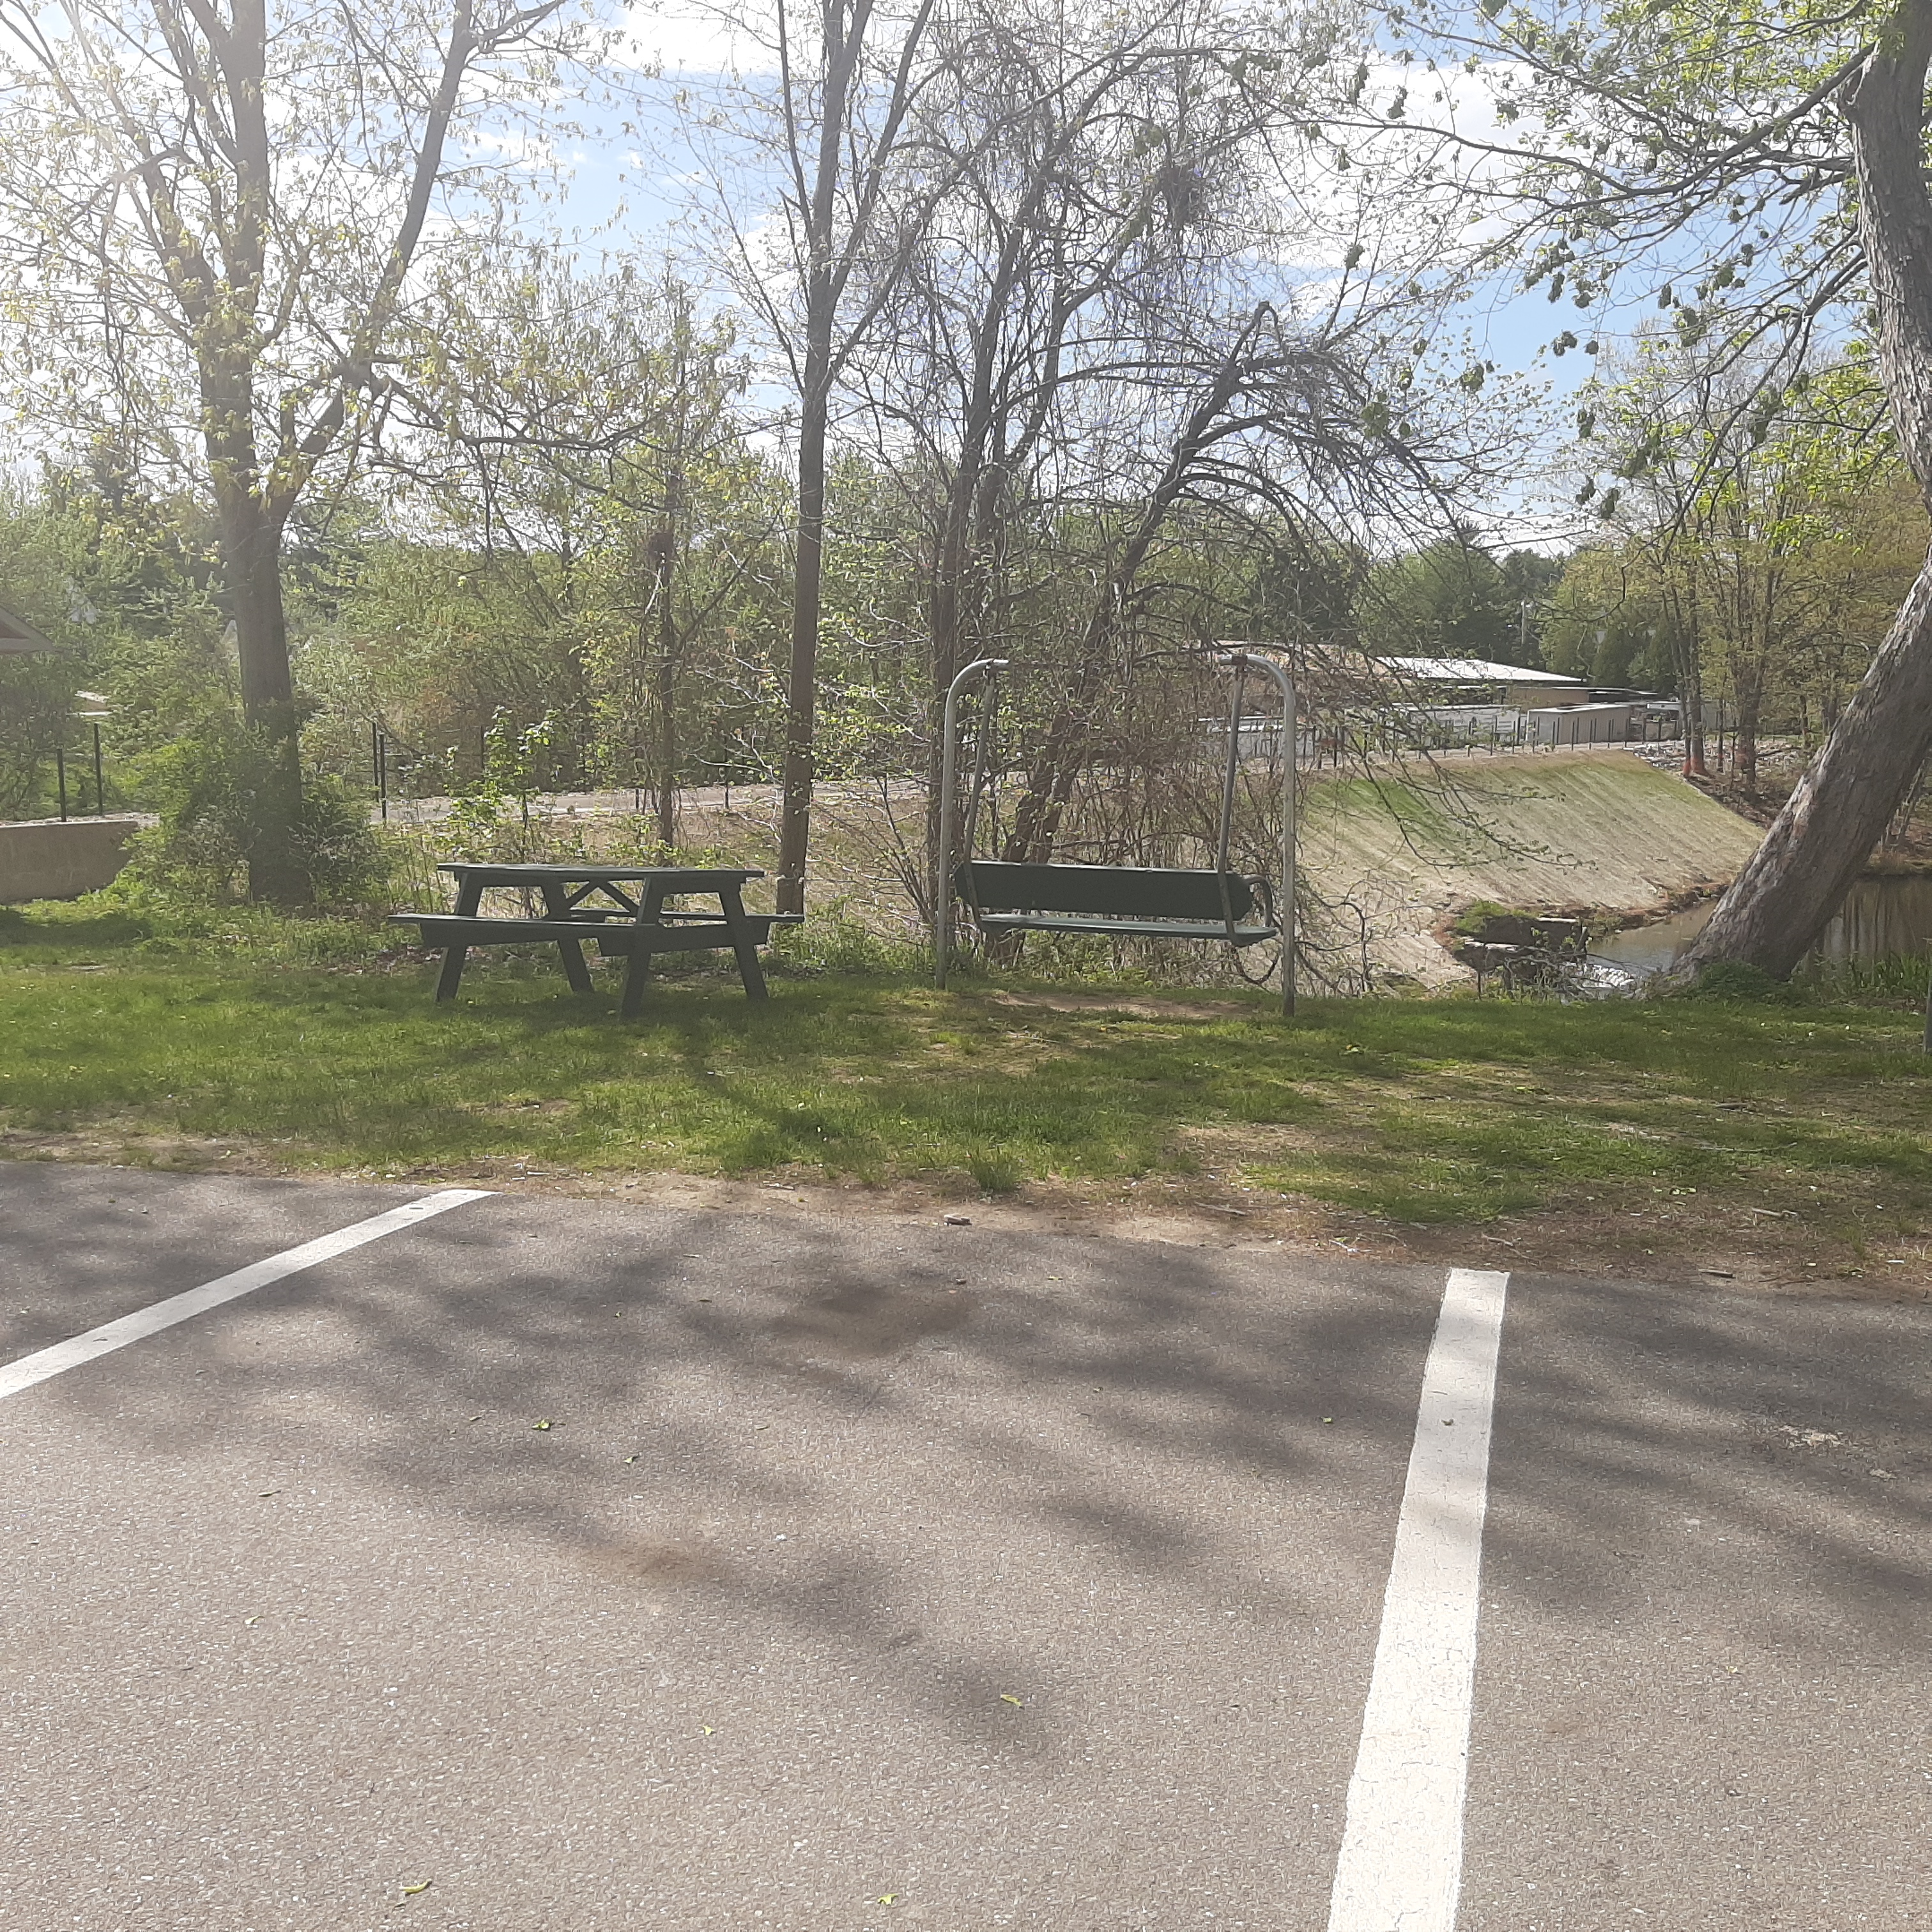
Hood Park Revitalizion
Short-Term Goals:
Seating, Signage and Landscaping

Slide 9
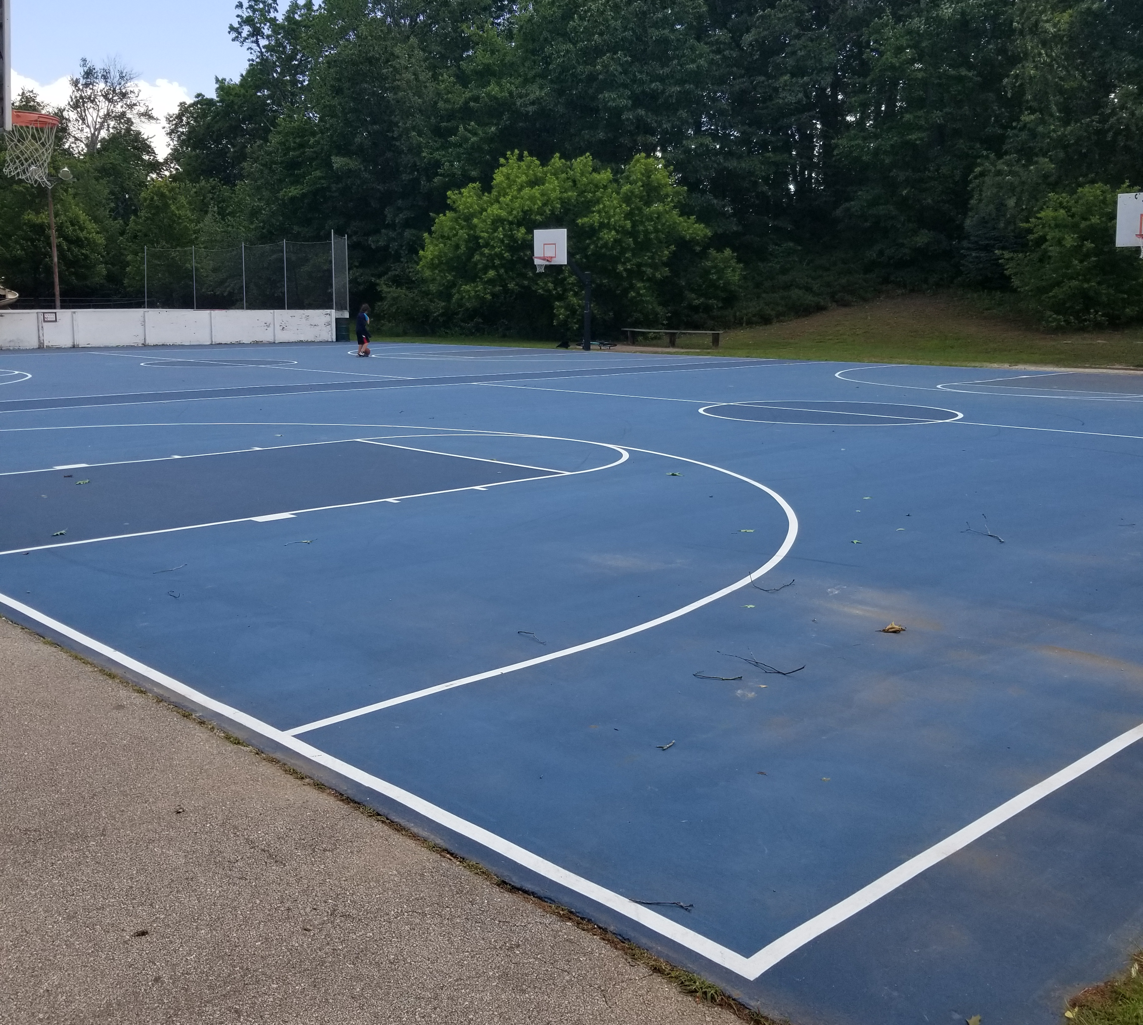
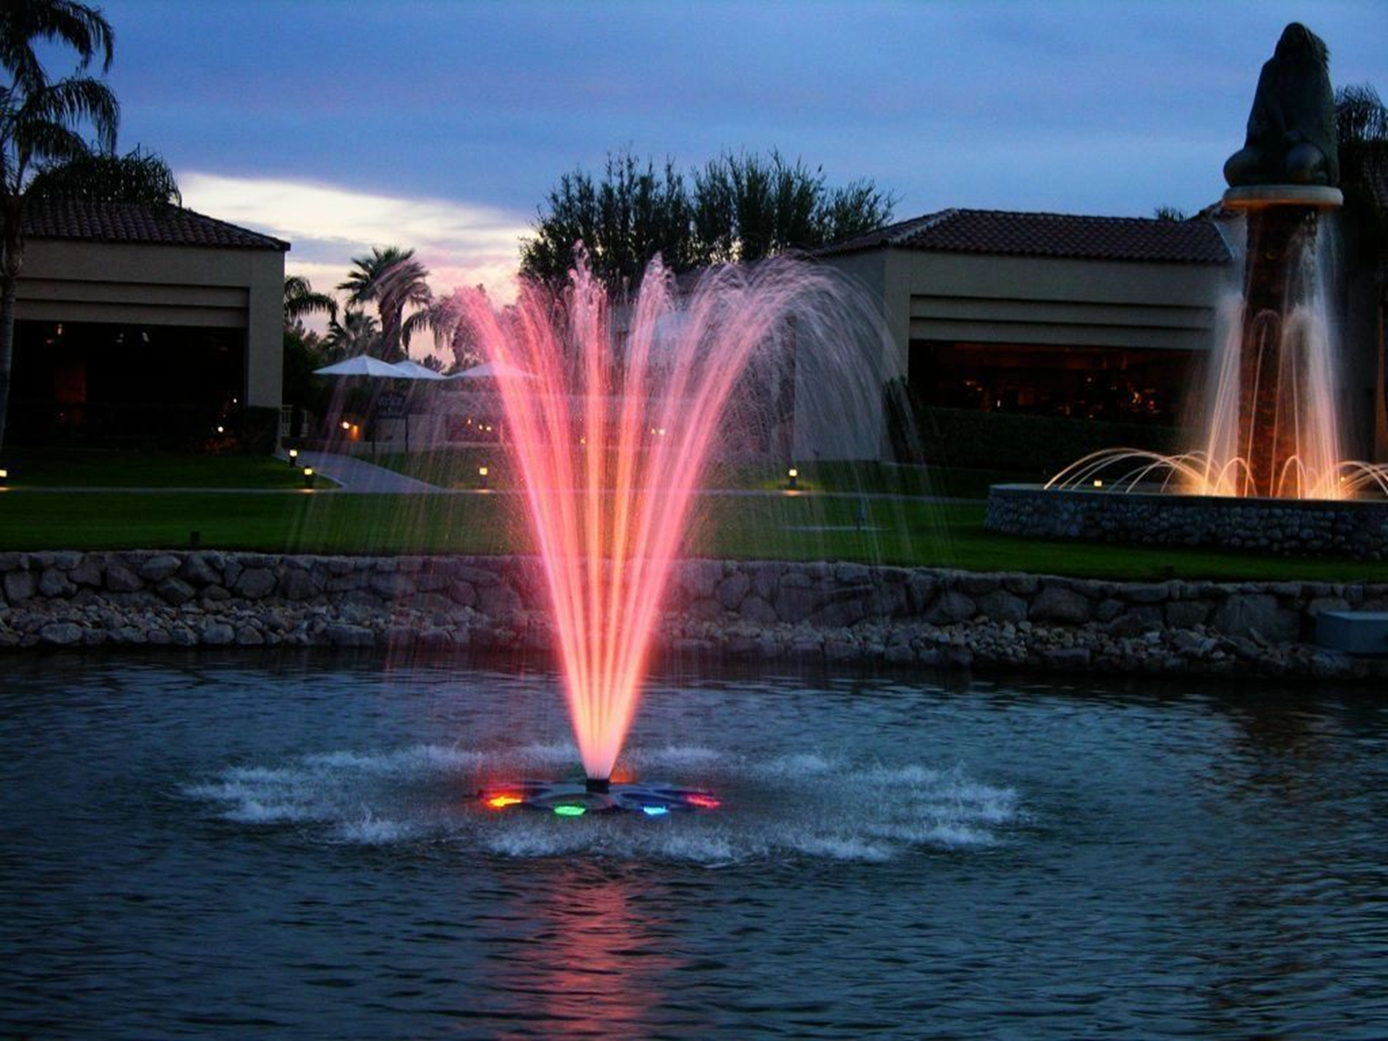
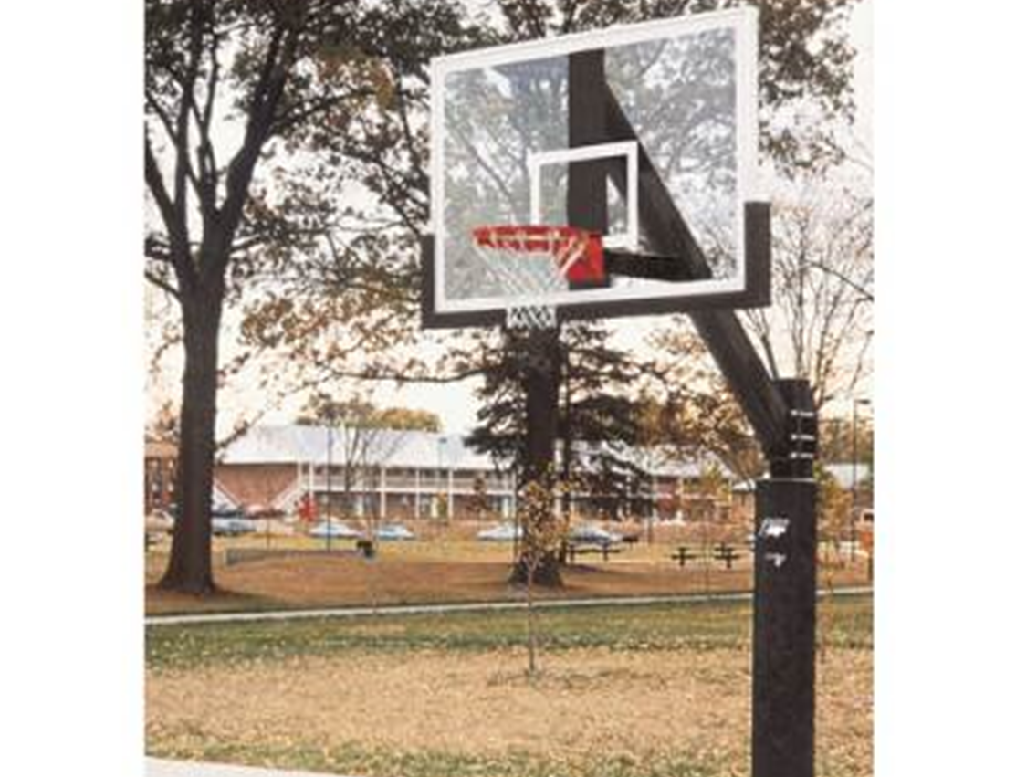
Hood Park – What’s Next?
Hockey Boards
Backboards
Fountain

Slide 10
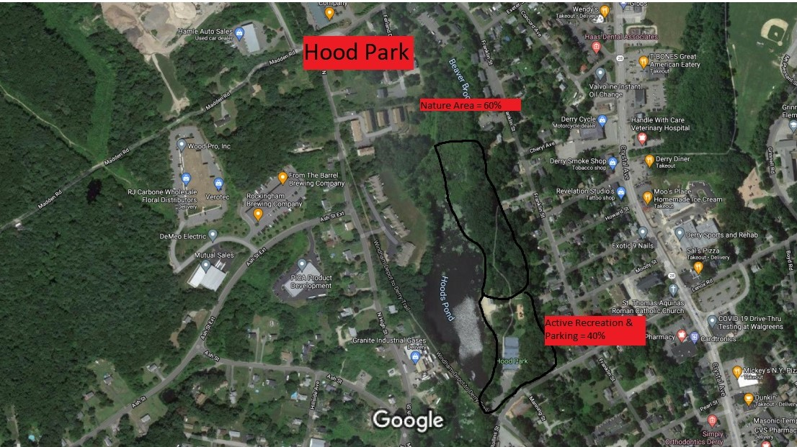

Hood Park Layout

Slide 11
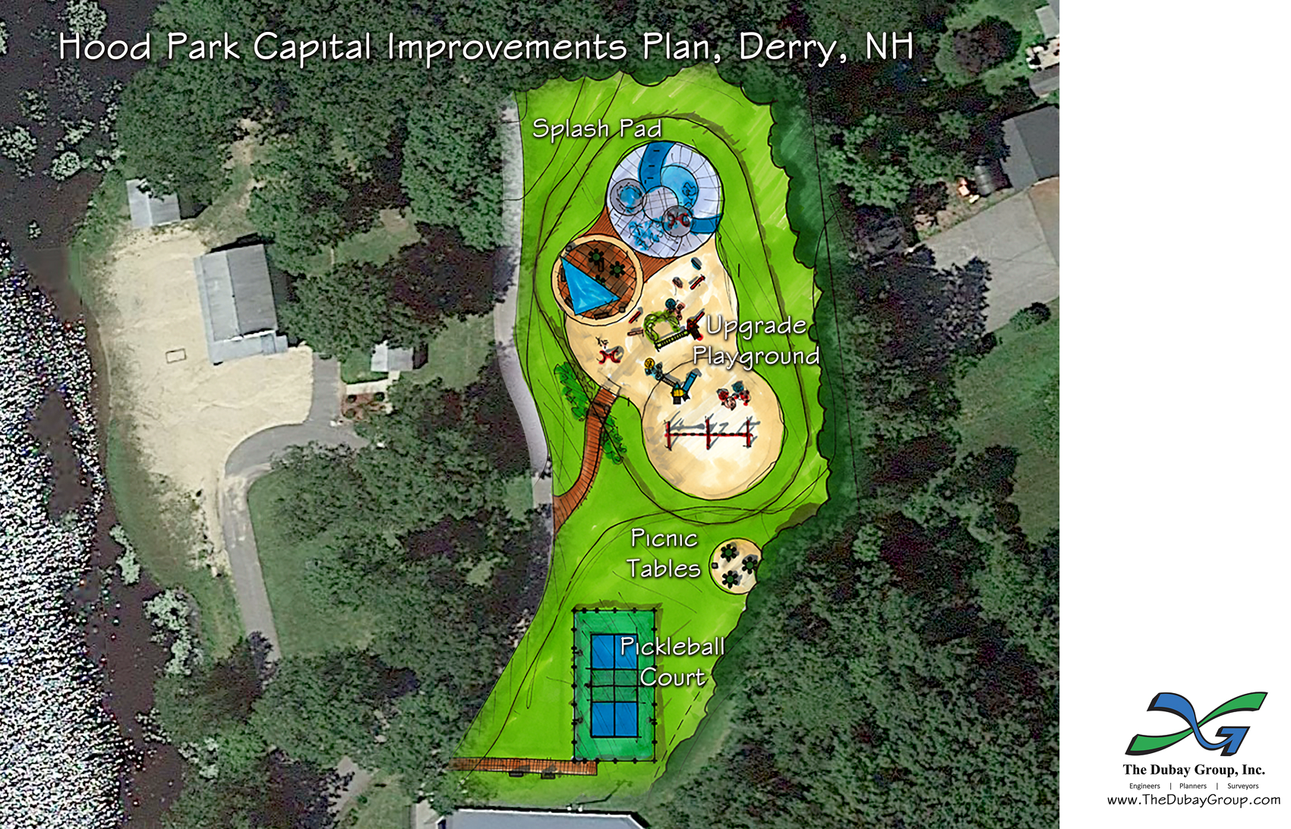

Slide 12
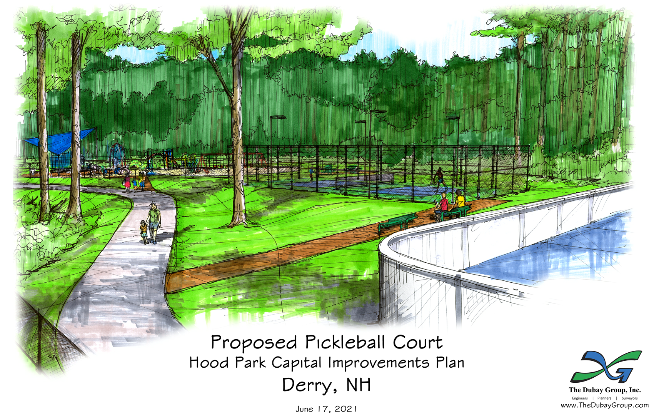

Slide 13
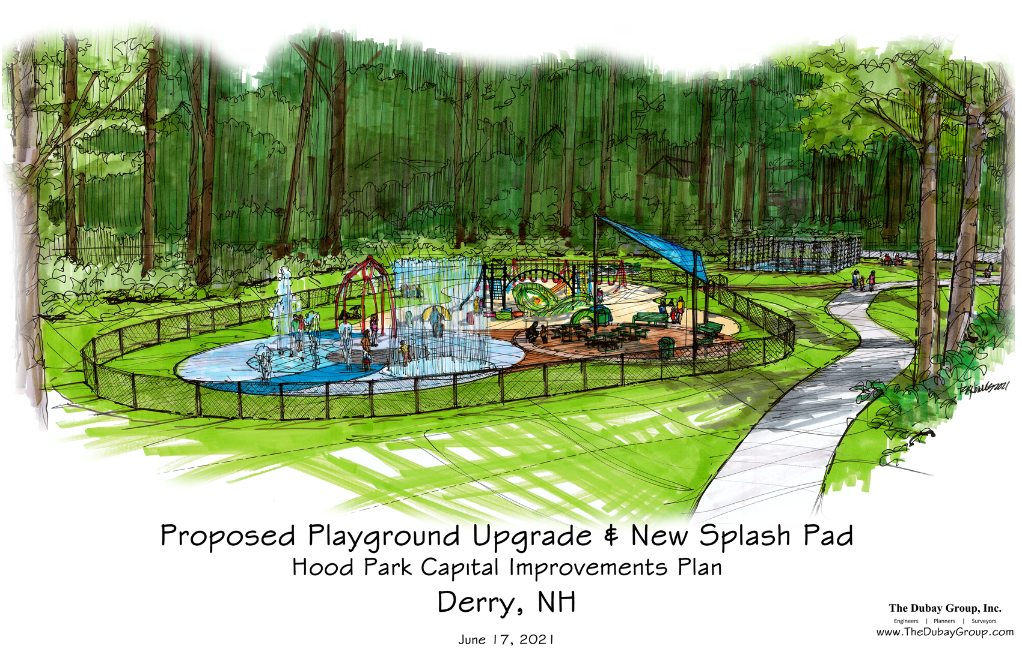

Slide 14
Hood Park
Timelines
Add landscaping – Completed
Add benches/tables – Completed
Rail Trail Grand Opening – June 15, 2021
Install Small Fishing Dock – July 2021
Install New Backboards – Fall 2021
Repaint Hockey Boards – Fall 2021

Slide 15
Hood Park
Timelines
Install New Netting – Fall 2021
Paint Bridge to trail area – Fall 2021
Install New Fountain – Fall 2021
Initiate Design for pickleball court – Winter 2021
Initiate Design for Playground – Winter 2021
Initiate Design for Splashpad – Winter 2021

Slide 16
Hood Park
Timelines
Engage PA for Trail Improvements– Fall 2021
Build Trail Improvements – Summer 2022
Lighting and CCTV – Summer 2022
Construct pickleball court – Fall 2022/Spring 2023
Construct Playground – Fall 2022/Spring 2023
Construct Splashpad – Fall 2022/Spring 2023

Slide 17
West Running Brook Field
Land partially owned by Town and School District
Add another multi-purpose field with lights
Allow Town maximum flexibility with field scheduling and usage
Engaged a Design/Engineering Firm to review, layout and estimate cost.

Slide 18












Slide 19
West Running Brook Field
Cost estimates (@ 100% build-out – lights, dugouts, maximum size) far exceeded resources available.
Estimated Project Costs = $2.4M
COUNCIL DIRECTION NEEDED
  A) Scaled down project
  B) Phase Project
  C) Seek alternate funding

Slide 20


Alexander – Carr Park
Playground Improvements – Spring 2022
Skate Park Upgrade – Spring 2022
AC Lodge Renovation – Decision to be made on scope of work and funding available
Funding for outside improvements/repairs funded from excess earnings on Trust (from Town Counsel)

Slide 21
Other Recreation Improvements
Rehab outfield area at Vet’s – O’Hara
Pickle Ball concept to resurface the existing court
Quotes are being solicited now to resurface in late Summer/Fall 2021
Don Ball Park Playground Equipment Upgrade – Summer 2021
CCTV upgrades at Don Ball and AC – Summer 2021
Rider Field #2 – Lights - TBD

Slide 22
Recreation Bond Status
Bond Amount: $1,800,000
LESS:
WRB Field Engineering: ($ 65,083)
Rail Trail Phase I: ($ 45,000)
Don Ball Playground: ($ 50,000)
Balance Available: $1,639,917

Slide 23
Funding Options for Recreation
Improvement Plan
Project Est. Cost Funding Sources
Hood Park $500,000 Rec Bond; DCC TIF
A-C Park improvements $100,000 A-C Trust Proceeds
Rider Field Lighting $200,000 Rec Bond
WRB Field $ 2.4M Rec Bond, Grants, Other
Ball, Vet’s/O’Hara Lights $150,000 Rec Bond

Slide 24
American Rescue Plan Act
Funded by the United States Government
Anticipated Funding to Derry - $3.505M
Funds sent to State for distribution
Payable in two tranches – 1st within the next month; 2nd in 12 months

Slide 25
American Rescue Plan Act
Allowable uses:
Respond to the health emergency and its negative economic impacts;
Premium pay for essential workers;
Continue government services by replenishing revenues;
Investments in water, sewer, broadband

Slide 26
American Rescue Plan Act
Each allowable use category has limitations and restrictions; funds identified as revenue replenishment are the most flexible, however:
Cannot prop up pension funds (n/a to Derry)
Cannot use funds to reduce taxes
Must be obligated by 12/31/24 and expended by 12/31/26
Cannot be used to replenish rainy day funds, surpluses, etc.
Cannot be used for legal settlements

Slide 27
American Rescue Plan Act
Calculations:
Calculate revenue from base year (FY19)
Revenue Derry’s revenue growth from FY16 – FY18 to establish trend (5% annually)
Calculate revenues on a calendar year basis for each year 2020-2024
Compare base year indexed at either 4.1% (law) or 5.0% (Derry) to determine anticipated revenues vs. actual revenues
Difference is that allowed as revenue replenishment

Slide 28
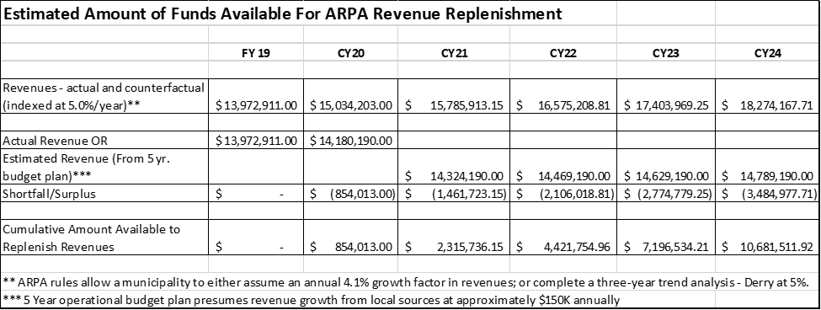
American Rescue Plan Act
All of Derry’s $3.505M allotment can be classified as revenue replenishment.

Slide 29
American Rescue Plan Act – Some Options
Town developed 5-year operational plan to successfully navigate exit from Pandemic era, which anticipated approximately $1.3M from ARPA.
Derry Revolving Loan Fund – replenish fund for additional loans under traditional guidelines – no more COVID emergency loans.
Water/Sewer Extensions – Possibly partnering with State ARPA Grants and SB 87 Funds.
a) $4.14M project to extend sewer to Ryan’s Hill
Capital Projects – Use additional ARPA revenues to replace State one-time FY20-21 biennium grant which was diverted to support operating budget.
Remove delays in Capital Improvements
Other capital projects – facility designs; Ryder lot paving; etc.

Slide 30
American Rescue Plan Act – Management & Looking Forward
Council previously created Expendable Trust Fund for the Derry Recovery Plan.
Council has voted to accept ARPA funds up to $3.315M.
DPW reviewing project lists for water and sewer enhancements.
Resolution presented at July 20 meeting to transfer portion of $1.3M to operating budget.
Need Council direction/input on further application of funds

