Slide 1
Hood Park Capital Improvement Plan
Originally Presented March 16, 2021
Updated June 22, 2021

Slide 2
Hood Park – How did we arrive here?
UNH Townwide Recreation Needs Study
Hood Park Subcommittee
Citizen Input
Staff Feasibility Analysis
Town Council Meeting February 16, 2021

Slide 3
Hood Park – Large Scale Map

Slide 4
Hood Park Court Improvements

Slide 5
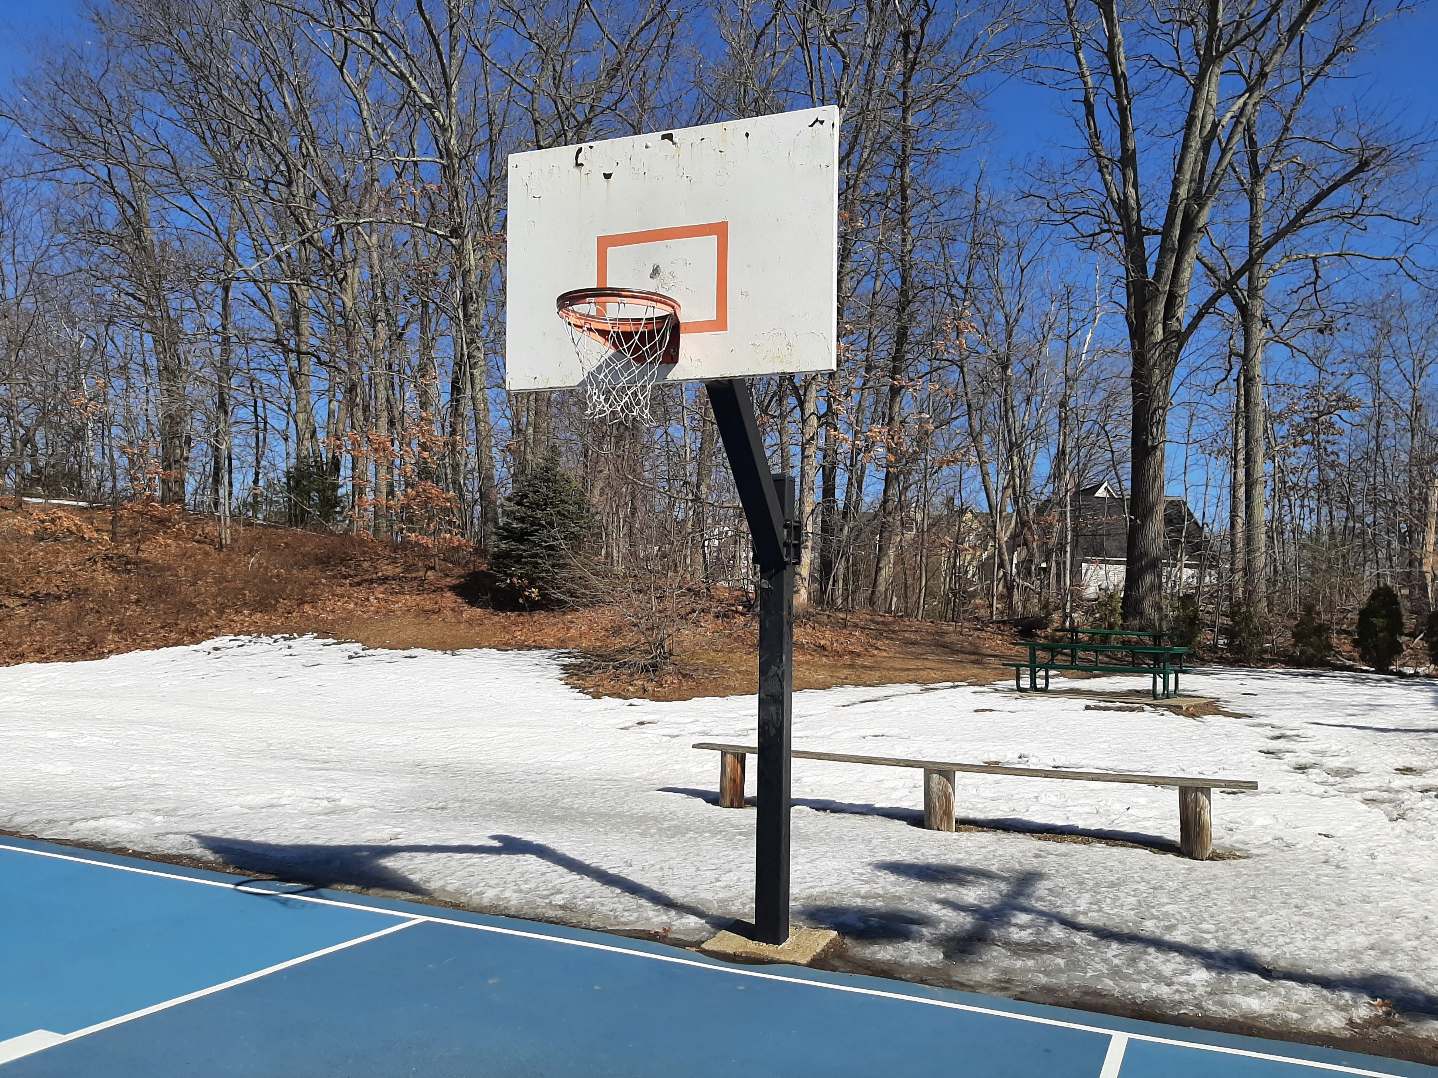

Slide 6
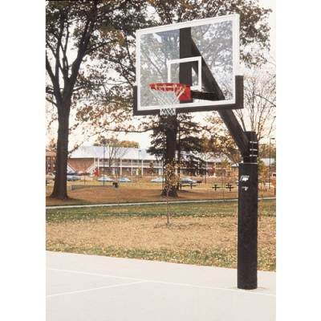

Slide 7
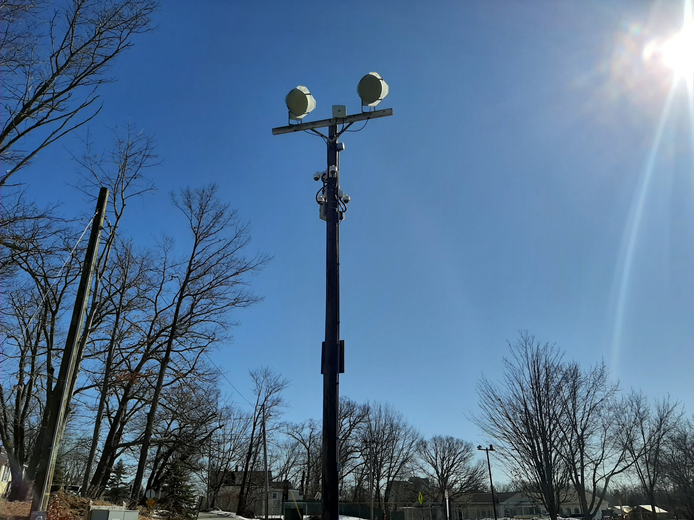

Slide 8
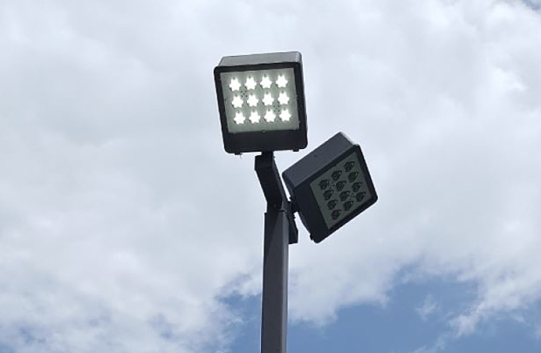

Slide 9
Hood Park New Pickle Ball Court

Slide 10
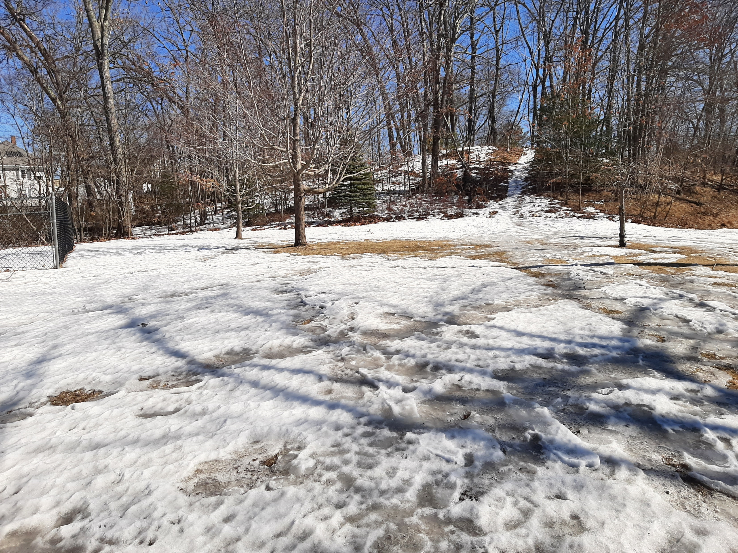

Slide 11
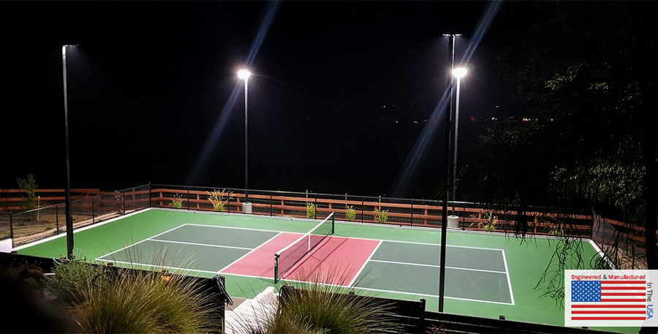

Slide 12
Hood Park Playground Upgrades

Slide 13
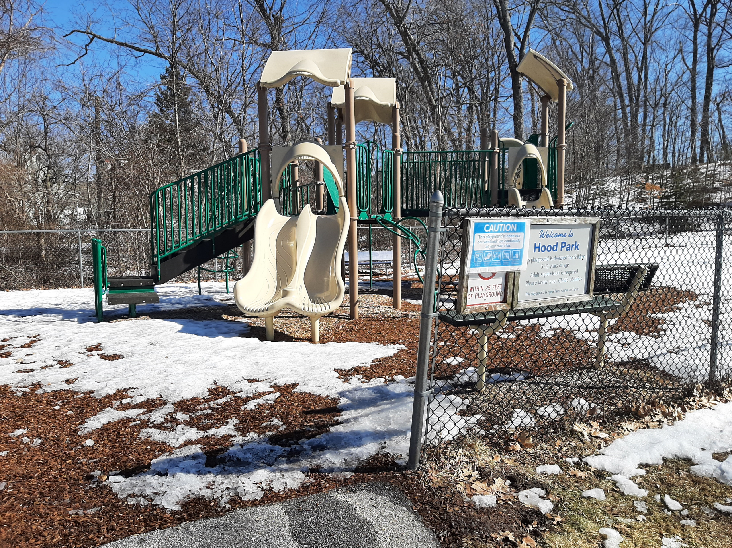

Slide 14
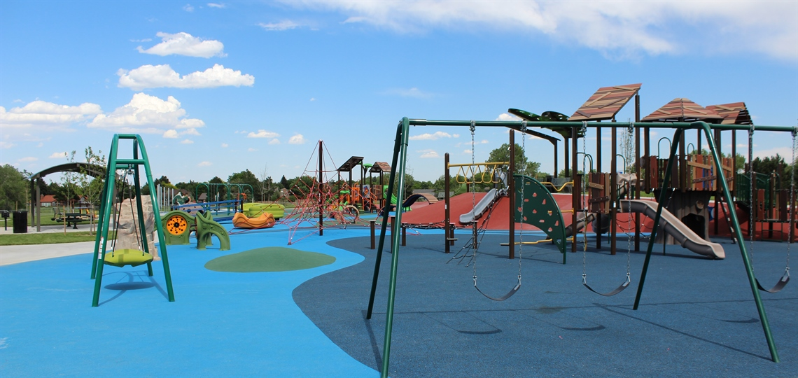

Slide 15
Hood Park New Splashpad

Slide 16
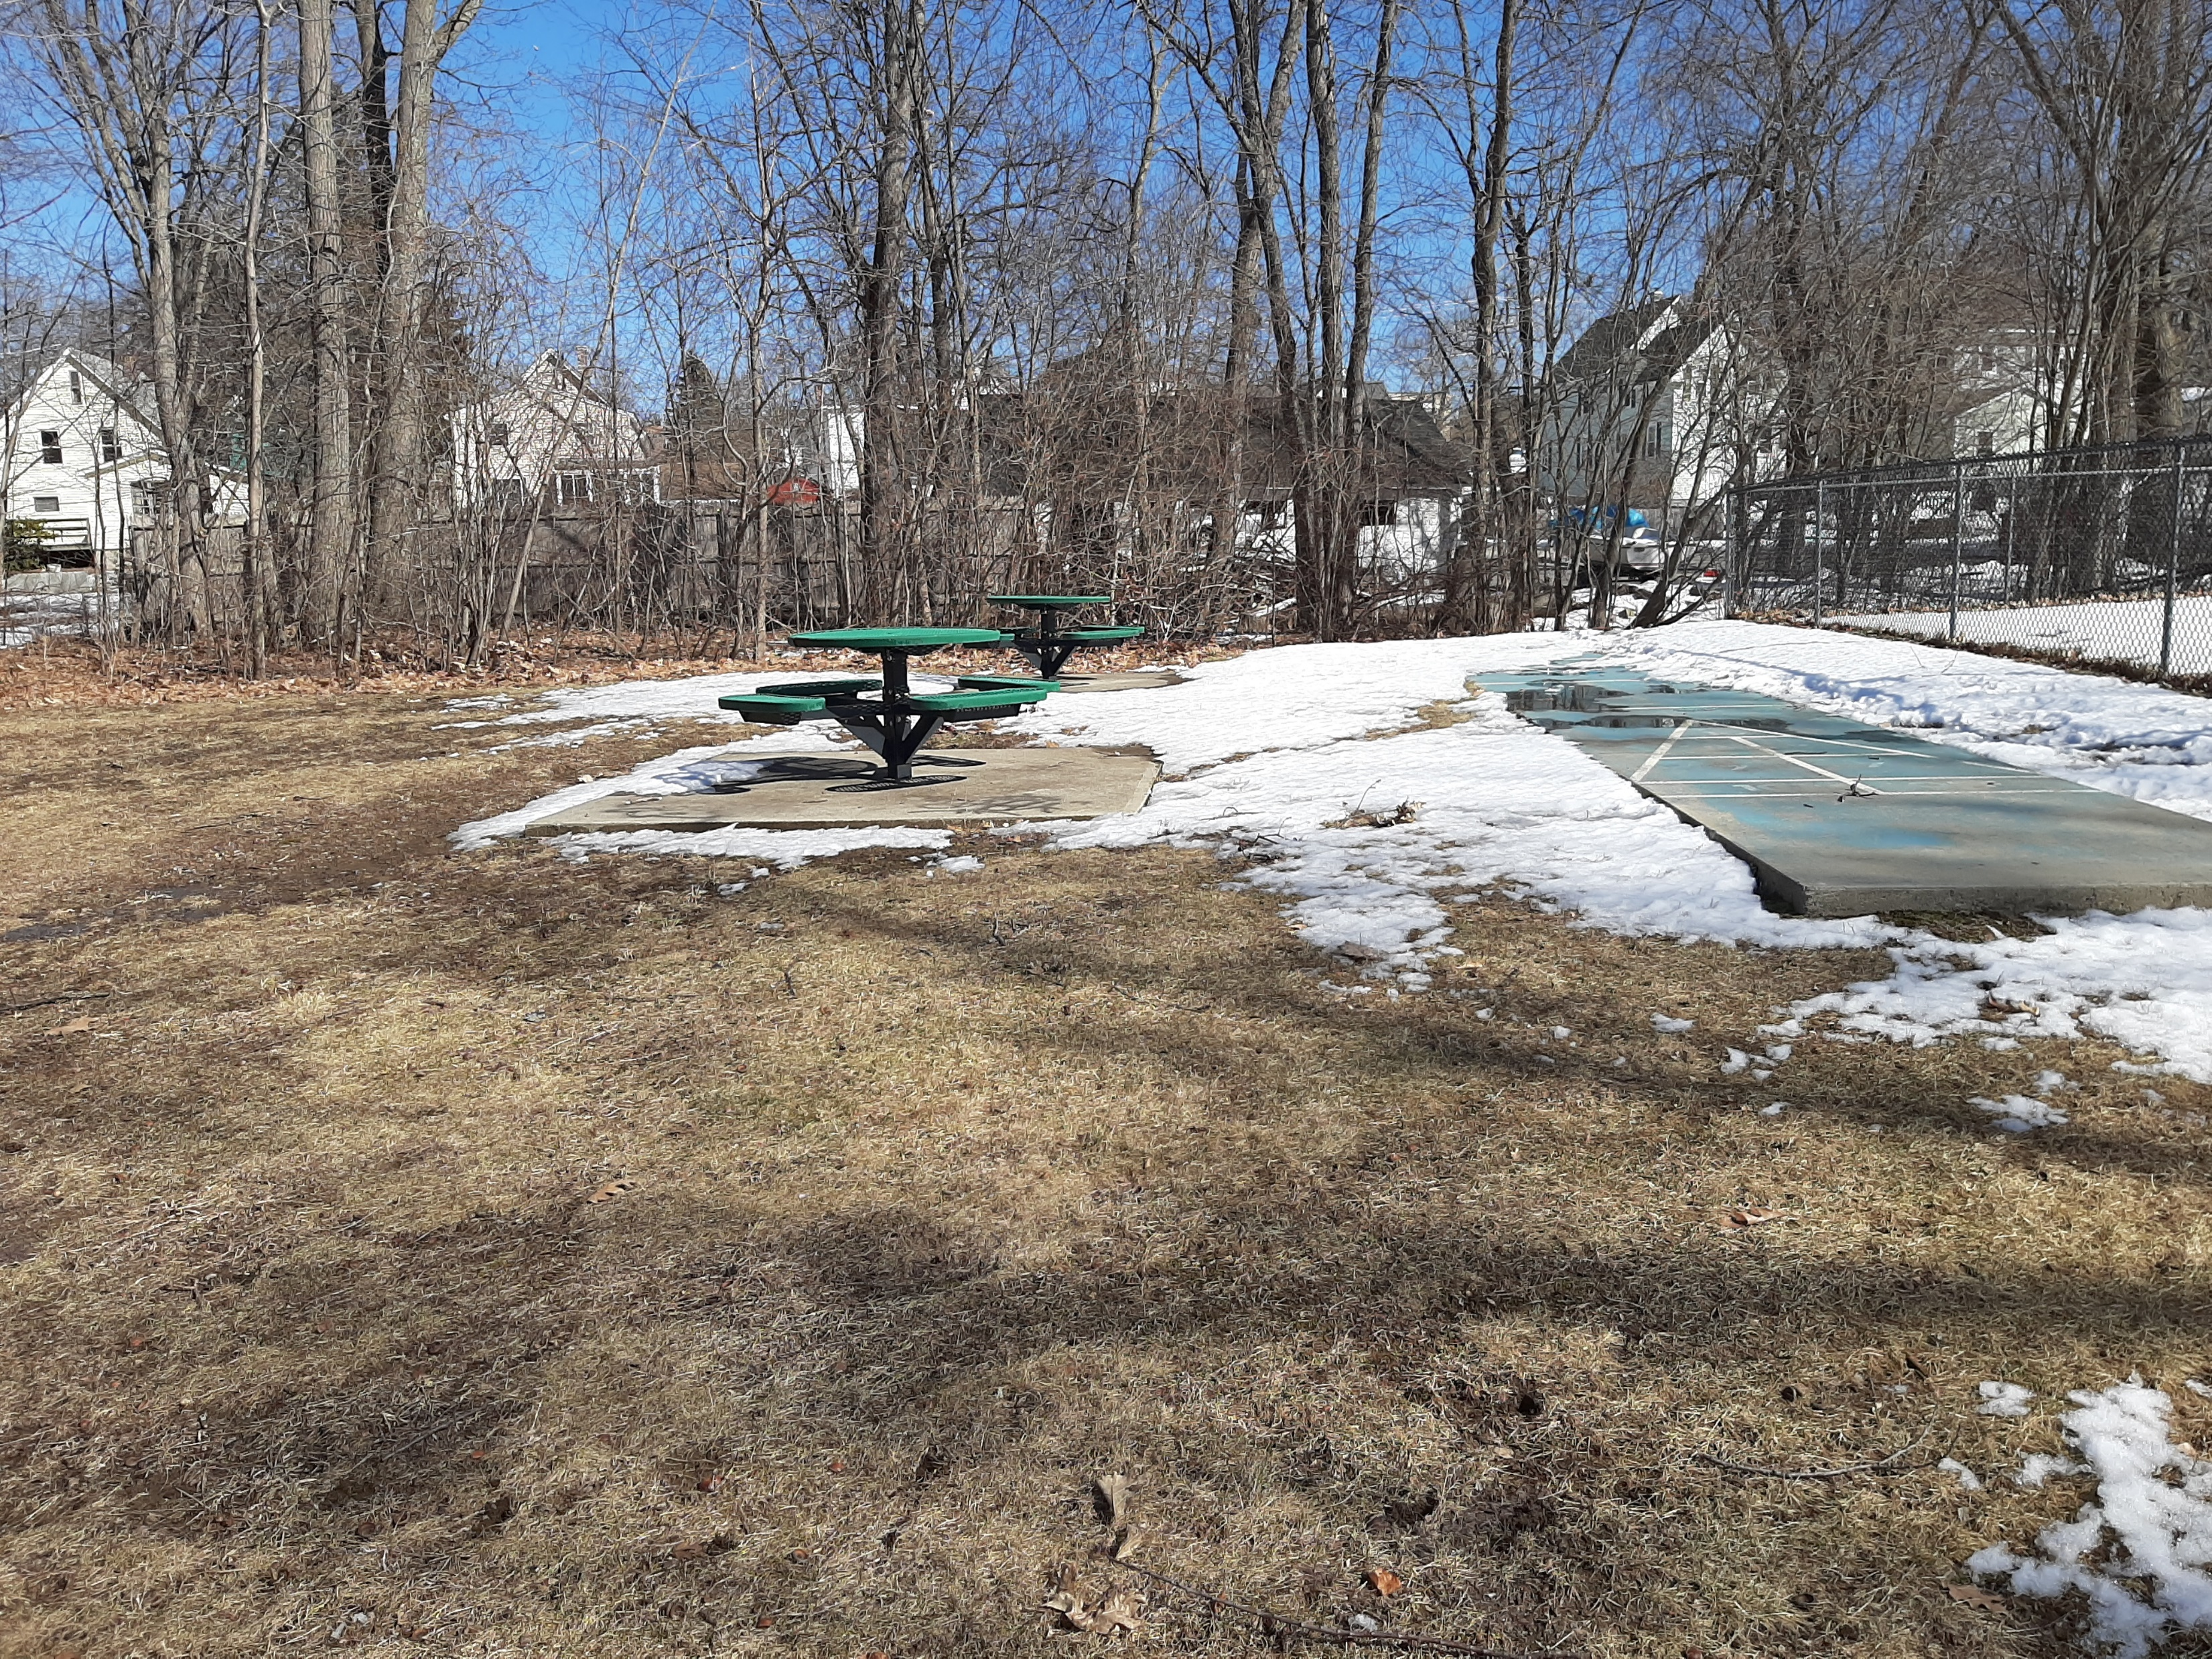

Slide 17
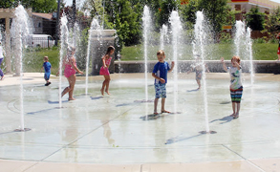

Slide 18
Hood Park Trail Improvements

Slide 19
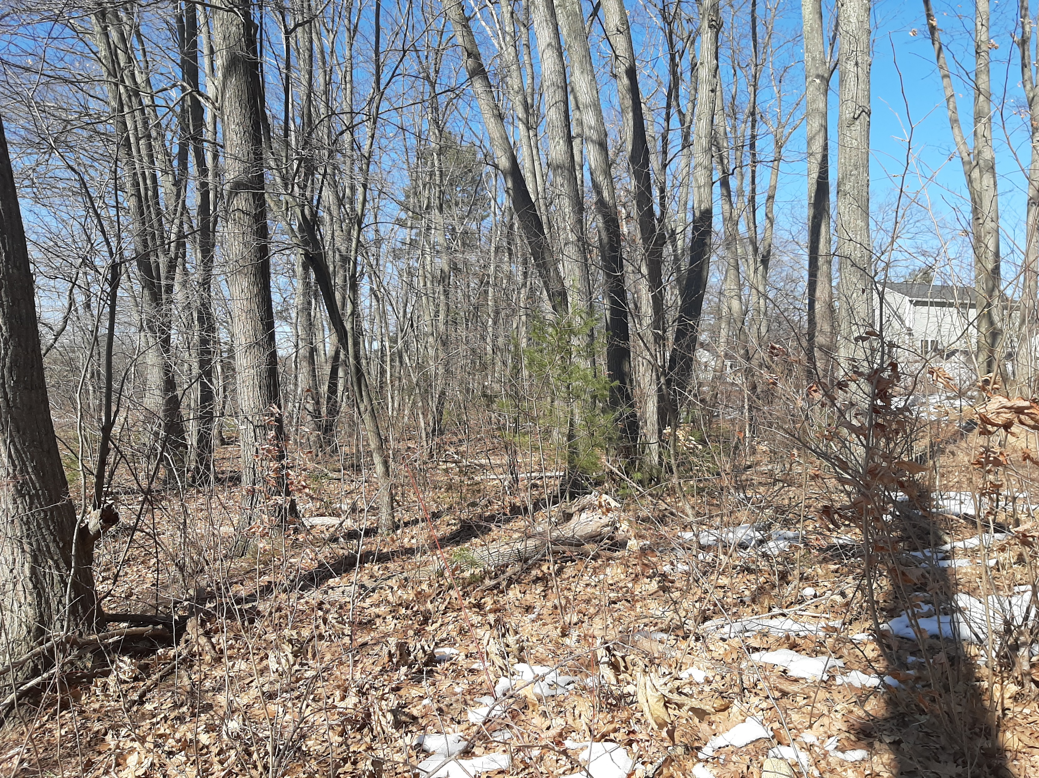

Slide 20
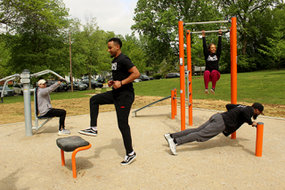

Slide 21
Hood Park Water Quality Improvements

Slide 22
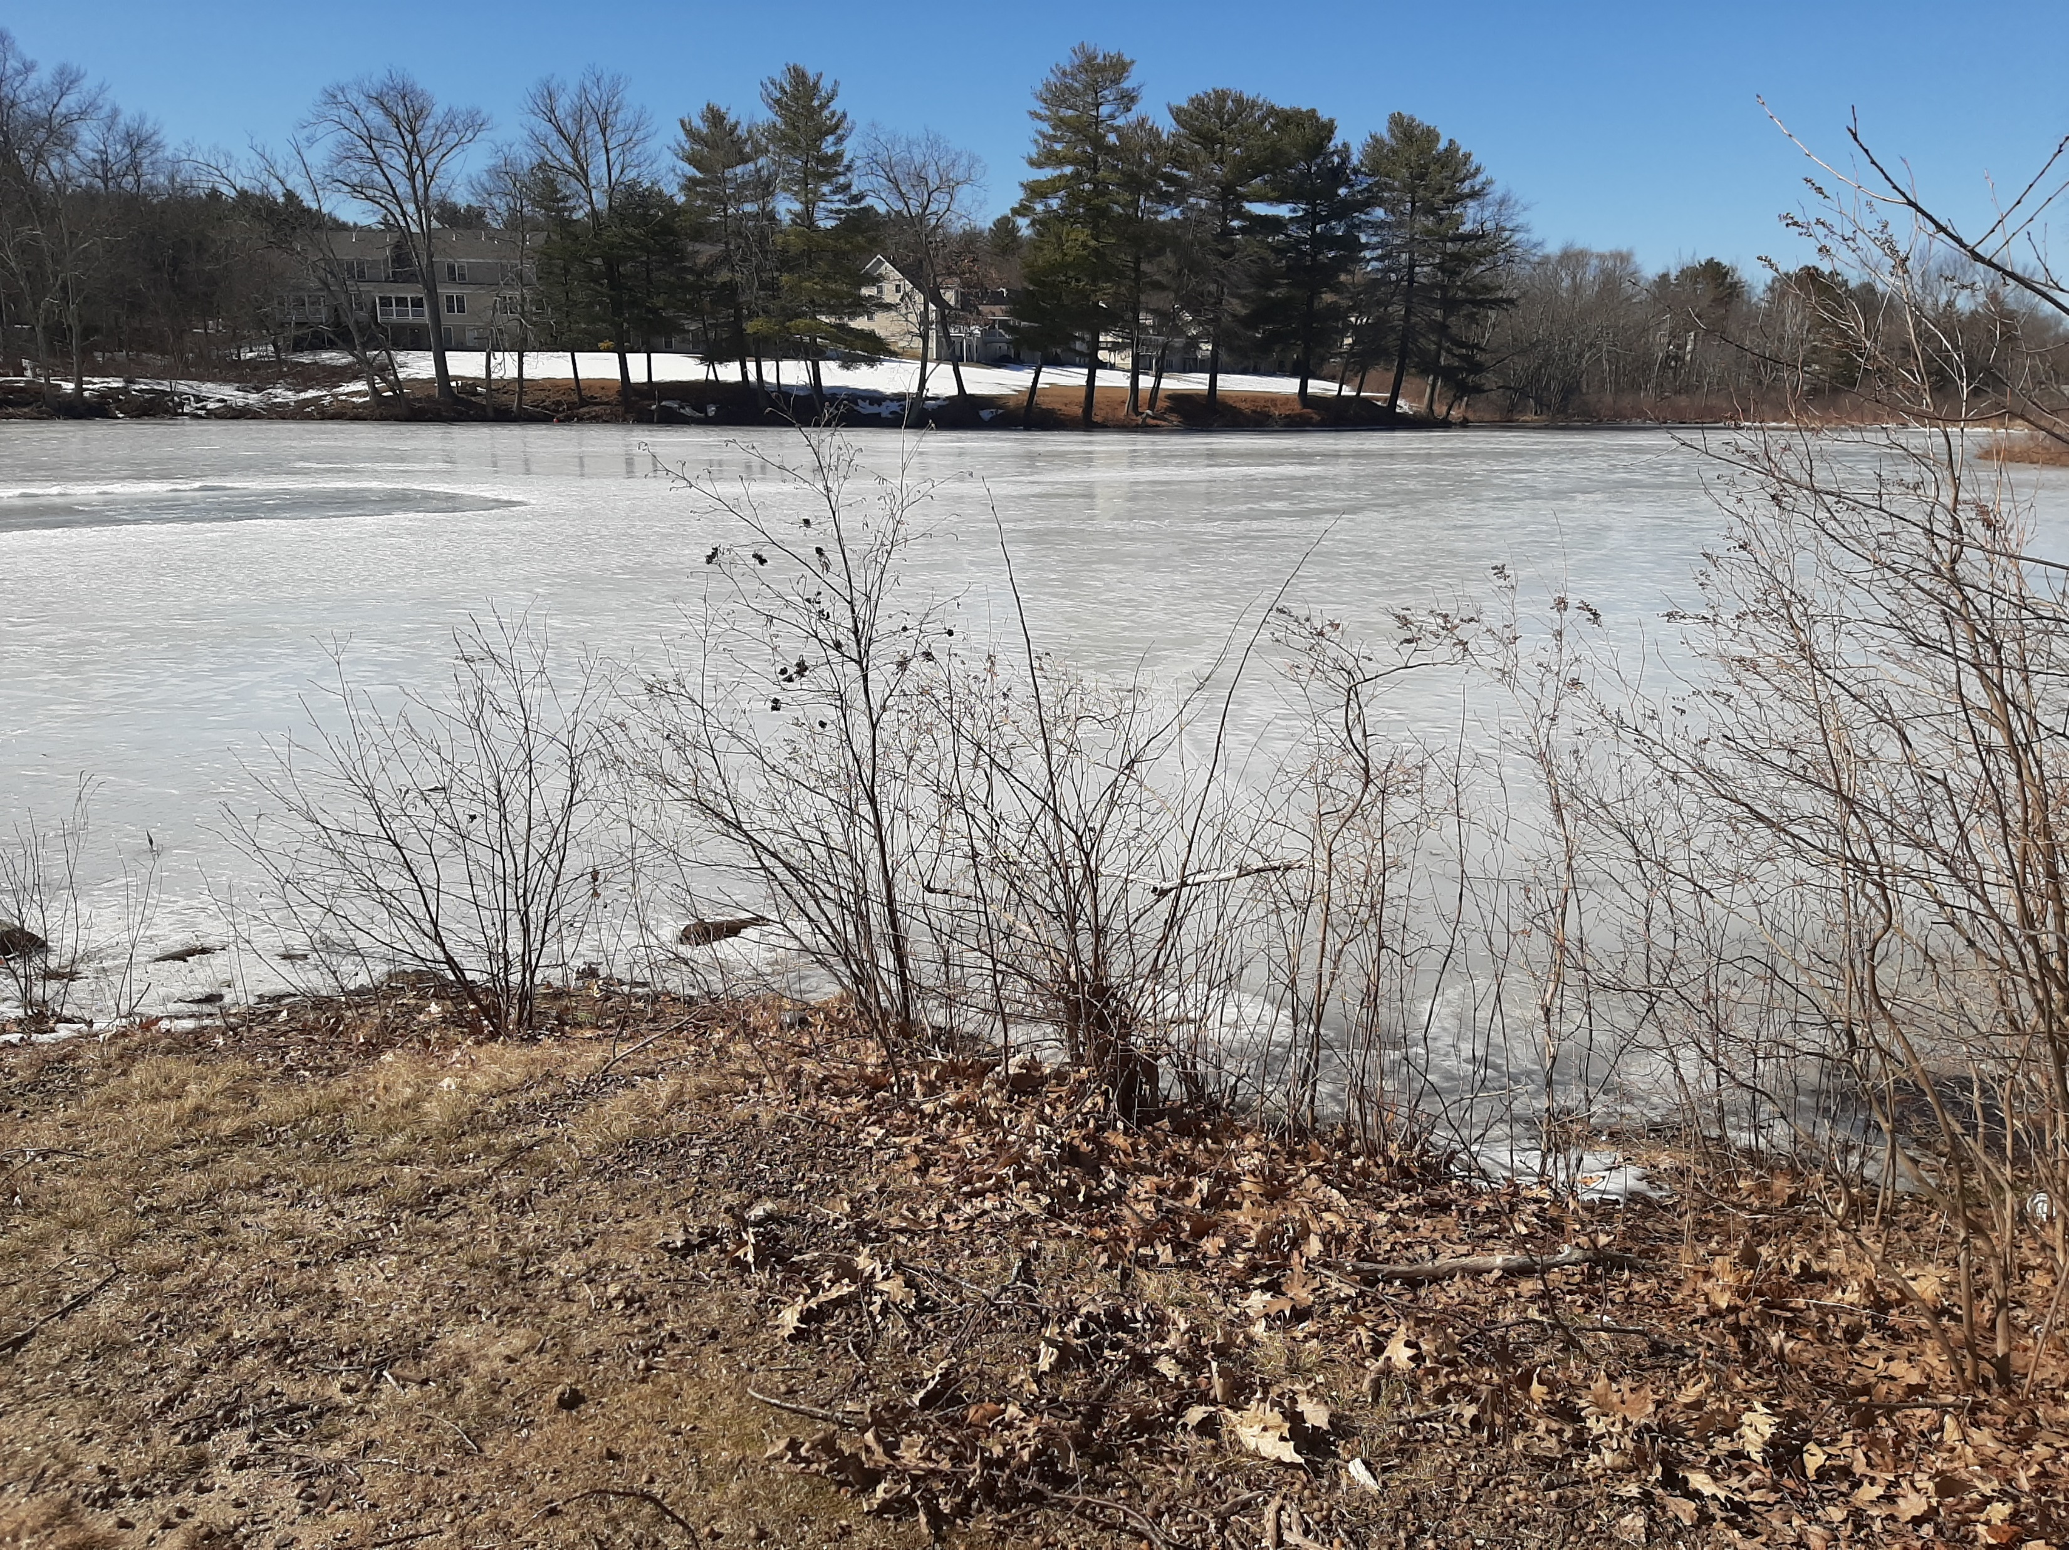

Slide 23
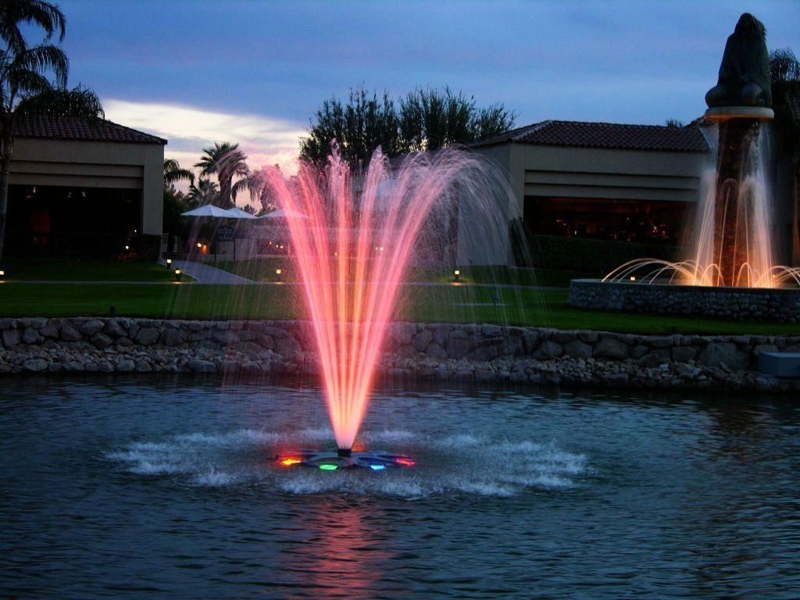

Slide 24
Hood Park – Proposed Capital Improvements
Court was repainted in September 2020
Four (4) Fiberglass Backboards $10,000
New Lighting and Security Cameras $100,000
Install New Netting $5,000
Refurbish Hockey Boards $5,000

Slide 25
Hood Park – Proposed Capital Improvements
New Pickleball Court $100,000
Playground Upgrades $50,000
New Splashpad $150,000
Install Fountain $15,000
Trail Improvements $50,000

Slide 26
Hood Park Timelines
Add landscaping – Completed
Add benches/tables – Completed
Rail Trail Grand Opening – June 15, 2021
Install Small Fishing Dock – July 2021
Install New Backboards – Fall 2021
Repaint Hockey Boards – Fall 2021

Slide 27
Hood Park Timelines
Install New Netting – Fall 2021
Paint Bridge to trail area – Fall 2021
Install New Fountain – Fall 2021
Initiate Design for pickleball court – Winter 2021
Initiate Design for Playground – Winter 2021
Initiate Design for Splashpad – Winter 2021

Slide 28
Hood Park Timelines
Engage PA for Trail Improvements– Fall 2021
Build Trail Improvements – Summer 2022
Lighting and CCTV – Summer 2022
Construct pickleball court – Fall 2022/Spring 2023
Construct Playground – Fall 2022/Spring 2023
Construct Splashpad – Fall 2022/Spring 2023

Slide 29
Hood Park Capital Plan
Confirm $500k funding from Rec Bond/DCC TIF
DPW/Parks to initiate design on larger projects
DPW/Parks to complete small-scale projects in 2021
DPW/Parks to construct large scale projects in 2022/2023
Future Ideas are always welcome

